Slide 1
ESE 3014 Embedded Systems Communication Protocol and Security
Prof. Linchen Wang (Revised and completed by Prof. Mike Aleshams)

Slide 2

Session – January 18

Slide 3
Electrical communication systems are designed to send message or information from a source to one or more destinations.
Information source
Input transducer
Transmitter
Channel
Output
signal
Output
transducer
Receiver

Slide 4
Transducer: It converts the output of a source into an electrical signal that is suitable for transmission.
E.g. A microphone serves as the transducer that converts voice (acoustic speech) into an electrical signal.
A video camera converts an image into an electrical signal.
At the output transducer, it converters the electrical signals to a form suitable of users.

Slide 5
Transmitter: It converts the electrical signal into a form that is suitable for transmission through the physical channel.
E.g. in radio and TV broadcast, the FCC (Federal Communications Commission) specifies the frequency range for each transmitting station.
So, transmitters must translate information signal into the appropriate frequency range, and multiple radio stations would not interfere with each other.
Similar functions in mobile communication system.

Slide 6
Mobile communication companies in Canada
MVNO
(7-11 Petro-Canada)
(postpaid) PC (prepaid)
Onstar Execulink
Rogers
Telus
Bell
Subsidiaries
Fido
Chatr
Koodo
Public Mobile
Virgin
UMTS
In NA
Band 5 850MHZ 824 – 849 Up 869 – 894 Down
Band 2 1900MHZ 1850 – 1910 Up 1930 – 1990 Down
Freedom Mobile Band 4 1700MHZ 1710 – 1755 Up 2110 – 2155 Down

Slide 7
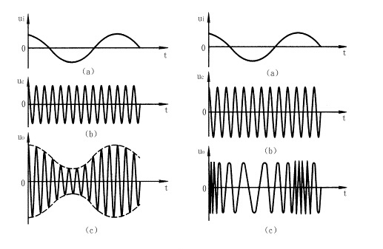
In transmitter, it can match the message signal to the channel and that is called modulation.
- Amplitude Modulation (AM) : the information signal is contained in amplitude variations. (535-1705 KHZ)
- Frequency Modulation (FM) : the information signal is contained in frequency variations. (88-108 MHZ)
Original Signal
Carrier Signal
AM
FM

Slide 8
Channel: the physical medium that is used to send the signal from transmitter to receiver
Wirelines: optical fiber, cable
Wireless: electromagnetic wave, micro wave
Additive signal distortion: noise
a) man-made: automobile ignition
b) natural: lightning in thunderstorms
Non-additive signal distortion: fading

Slide 9
The receiver: it recovers the message signal contained in the received signal.
In may contain demodulation, filtering, or noise suppression

Slide 10
In the system above, we assume message signal is a continuous time varying waveform, we refer that continuous-time signal as analog signal, and the information source as analog source. So we can call this communication system an analog communication system.
On the other hand, an analog source output can be converted into a digital form, and message can be transmitted via digital modulation and demodulation.
But why we need to convert analog into digital?

Slide 11
Reason:
1. The signal fidelity is better in digital transmission than analog transmission. In long-term transmission, digital transmission allows us to regenerate the digital signal in each regenerate point; however, in analog transmission, noise is amplified with signal when amplifiers are used periodically to boost the signal.
2. analog signal may be highly redundant.
3. digital communication system are often cheaper to implement.

Slide 12
Digital signal system
Information source
& Input transducer
Source encoder
Channel
encoder
Digital
modulator
Channel
Output transducer
& Output signal
Source decoder
Channel
decoder
Digital
demodulator

Slide 13
Source: It may be either analog signal e.g. audio, video
Or digital signal e.g. output of computer
In source encoder: we seek an efficient representation of the source output (eliminate redundancy) that results in little or no redundancy, so encoder convert the output either analog or digital source into a sequence of binary digits. This is called encoding or compression.

Slide 14
In channel encoder: add some redundancy to overcome the effects of noise and interference in the transmission.
Channel encoder
Noise
Say apple
a a p p p p l l e e
a ? p ? p ? ? l ? e
a p p l e
There are two ways to ensure information communication:
1 increase signal/noise ratio
2 add redundancy.

Slide 15
In digital encoder: map the binary information sequence into signal waveforms. It means use different waveforms to represent different bit information.
Say we want to play a melody with four tones (00, 01 ,10 ,11). We play 100 tones per second, so the symbol rate is 100 symbol or baud/s, each tone is represented by two bits. Which bit rate is 200 bit/s

Slide 16
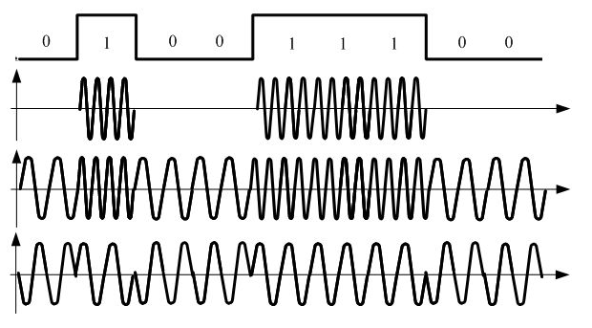
We use shift keying in digital encoder.
ASK (Amplitude shift keying)
FSK (Frequency shift keying)
PSK (Phase shift keying)

Slide 17
Digital decoder: Process waveform to data symbol.
Channel decoder: Determine and pick up the signal we want from a lot of signals we get.
Source decoder: Attempts to reconstruct the original signal from the source.

Slide 18
Channel
Physical media that do transmission
We choose five different channels for special attenuation, Telephone channels, Twisted-pair, Optical fibers, Mobile radio channels, and Satellite channels.
They play important roles in today’s communication environment.

Slide 19
Telephone channel
It uses a switching mechanism called circuit switching to establish an end – to – end communication link on a temporary basis.
The primary purpose of the network is to ensure that the telephone transmission between a speaker at one end and a listener at the other end.
In this form, message source is : sound from speaker’s voice to listener’s ear.
Transducer: a microphone is placed near speaker’s mouth to convert sound waves into an electrical signal. And a moving – coil receiver is placed near listener’s ear to convert electrical signal back into acoustic form.

Slide 20
Telephone channel
Nowadays, these transducer can respond well to frequencies from 20 to 8000 Hz
The telephone channel is essentially a linear, bandwidth – limited channel.
A speech signal is essentially limited to a band from 300 to 3100 Hz, and frequencies outside this band range do not contribute much to articulation efficiency.

Slide 21

Telephone channel
E.g. Call someone and play 1000Hz, 2000Hz, and 3000Hz from a computer, the person will be able to hear that tone. However, the person will have trouble to hear 4000Hz sound, and will not hear anything in 5000Hz and 6000 Hz. That is because telephone channel “clips” them.
And that is why someone’s voice on a telephone channel is different from face - to - face communication.

Slide 22
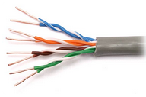
Twisted-pair
It is the ordinary copper wire that connects home and many business computers to the telephone company.
To reduce crosstalk or electromagnetic induction between pairs of wires, two insulated copper wires are twisted around each other. Each connection on twisted pair requires both wires.

Slide 23
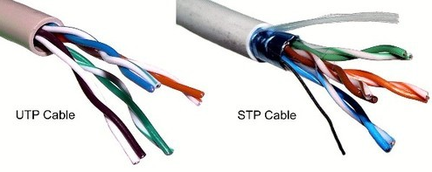
Twisted-pair
For some business locations, twisted pair is enclosed in a shield that functions as a ground. This is known as shielded twisted pair (STP). Ordinary wire to the home is unshielded twisted pair (UTP).

Slide 24
Twisted-pair
Category 1—Used for telephone communications. Not suitable for transmitting data.
Category 2—Capable of transmitting data at speeds up to 4 megabits per second (Mbps).
Category 3—Used in 10BASE-T networks. Can transmit data at speeds up to 10 Mbps.
Category 4—Used in Token Ring networks. Can transmit data at speeds up to 16 Mbps.
Category 5—Can transmit data at speeds up to 100 Mbps.
Category 5e —Used in networks running at speeds up to 1000 Mbps (1 gigabit per second [Gbps]).

Slide 25
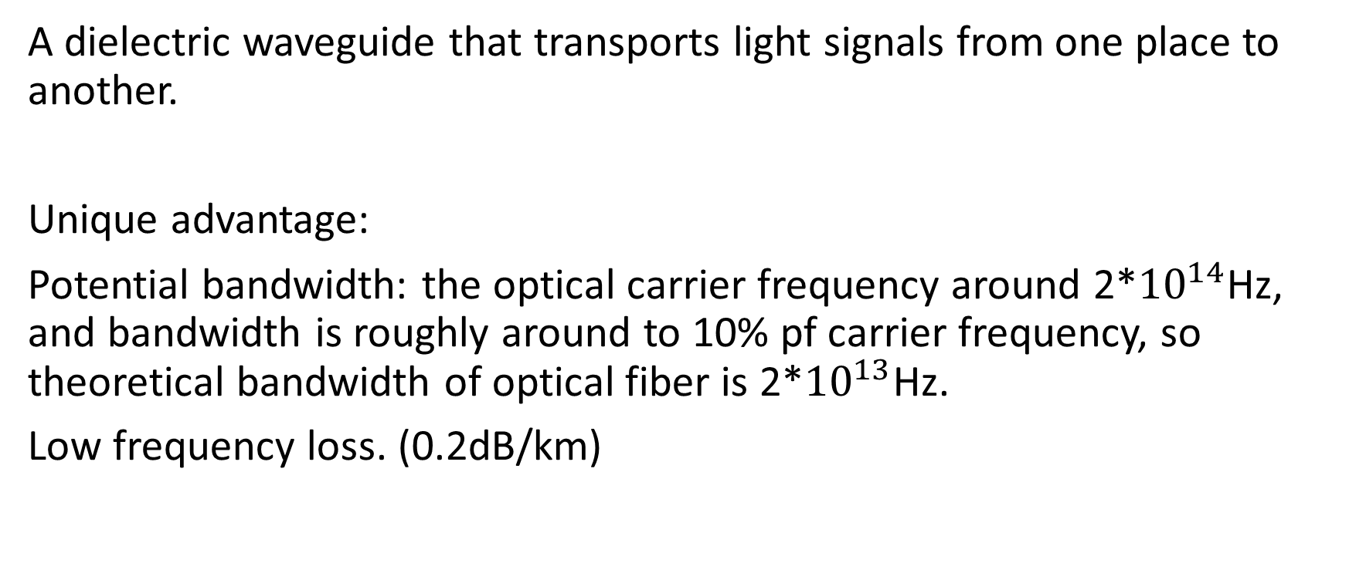
Optical fiber
A dielectric waveguide that transports light signals from one place to another.
Unique advantage:
Potential bandwidth: the optical carrier frequency around 2*${10}^{14}$Hz, and bandwidth is roughly around to 10% pf carrier frequency, so theoretical bandwidth of optical fiber is 2*${10}^{13}$Hz.
Low frequency loss. (0.2dB/km)

Slide 26
Optical fiber
Immunity to electromagnetic interference: a characteristic of optical fiber as a dielectric waveguide.
Small size and weight: a diameter no greater than human hair.
Ruggedness and flexibility: high tensile strengths and possibility of being bent or twisted without damage.
Low cost: silica glass made from sand, unlike cable used in metallic conductor.

Slide 27

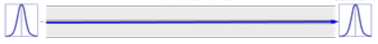
Optical fiber
Multi mode fiber (MMF) and Single mode fiber (SMF). The diameter of MMF is bigger than SMF (SMF can be um). So the cost of SMF is higher than MMF, as we need semiconductor laser unit to send pulse in SMF, whereas we only need luminous diode in MMF.
In the transmission, the angle of the MMF light is larger, so it tends to decay. However, the transmission distance of SMF is much longer (10-70 km).
MMF
SMF

Slide 28
Mobile radio channel
It extends the capability of the public telecommunications network by introducing mobility into the network.
There may be a multitude propagation paths with different electrical lengths, and their contributions to the received signal could combine in a variety of ways.
So, a mobile channel may be viewed as a linear time-varying channel.

Slide 29
Satellite channel
It provides broad – area coverage communication.
Two requirements:
1. satellite should keep an altitude of 22,300 miles, and it is geosynchronous with each station.
2. It is placed directly above the equator (no any angle).
So earth station do not have to track the satellite, and just point its antenna along a fixed direction.

Slide 30
Satellite channel
Broad – area coverage.
Reliable transmission links.
Wide transmission bandwidth. 6GHz uplink and 4 GHz downlink
A typical satellite is assigned a 500 MHz bandwidth and is divided among 12 transponders. Each transponder using approximately 36 MHz of satellite bandwidth. That can carry at least one color TV signal, 1200 voice circuits or digital data at rate of 50mb/s.

Slide 31
Multiplexing
Multiplexing: a method by which multiple signal are combined into one signal over a shared medium.
Frequency-division multiplexing: combining of several signal into one medium by sending signal in several distinct frequency ranges over a single medium.
Rogers, Telus, Bell: Band 2 850MHZ 824~849 ↑ 869~894 ↓
Band 5 1900MHZ 1850~1910 ↑ 1930~1990 ↓
Freedom Mobile : Band 4 1700MHZ 1710~1755 ↑ 2110~2155 ↓

Slide 32
Multiplexing
Time-division multiplexing: it uses time frame to separate the different data stream over shared medium.
Conversation A A
Conversation B B
Conversation C C
Need time synchronization
Time t
Time t+1

Slide 33
Multiplexing
Code-division multiplexing: multiple data signals are combined for simultaneous transmission over a common frequency bandwidth. And when CDM is used to allow multiple users to share a single communication channel, the technology is called code division multiple access (CDMA)
Why we choose CDMA, it doesn’t require the bandwidth allocation of FDM, not the time synchronization needed in TDM. Most important, it can minimize the interference from each other (users).

Slide 34
CDMA
Code-division multiple access (CDMA) is a channel access method used by various radio communication technologies. CDMA is an example of multiple access, where several transmitters can send information simultaneously over a single communication channel. This allows several users to share a band of frequencies (see bandwidth). To permit this without undue interference between the users, CDMA employs spread spectrum technology and a special coding scheme (where each transmitter is assigned a code)
How I understand CDMA, like Caesar cipher, we assign a specific code, called “spreading code” for a pair of user, only this pair of user can understand each other by using this specific code, and all other message will be considered as noise.
One example: We might add codes to make as mask card using optical technology that is called OCDMA.

Slide 35
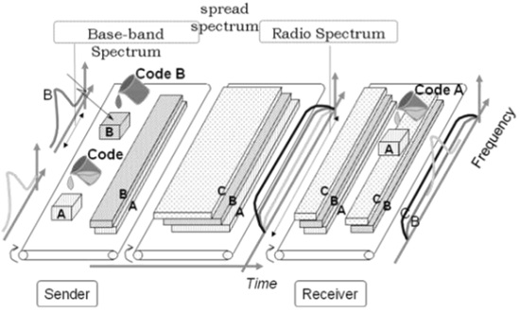
CDMA

Slide 36
OCDMA
We call each piece of information covered by a mask card as a ``chip”
Unordered message
Cover user A’s mask card, and get A’s message ``LOVE”
Cover user B’s mask card, and get B’s message ``YORK”

Slide 37
CDMA
Another example can be consider as language.
If you know a language, then you have this specific code of language in your brain.
You can understand the language you know, and filtrate the language you don’t know.

Slide 38
CDMA
Say you are on a train of a long journey, and you are sleepy. But there are two guys sit behind you are chatting.
Case 1. You don’t know their language, and you don’t have the code of this language in your brain, so you have no idea what they are talking about, and you can consider the voice is noise. You can keep sleeping if their voice is not loud.
Case 2. You know their language, and you have the code of this language in your brain. So you know what they are talking about, and it will be hard for you to keep sleep.

Slide 39
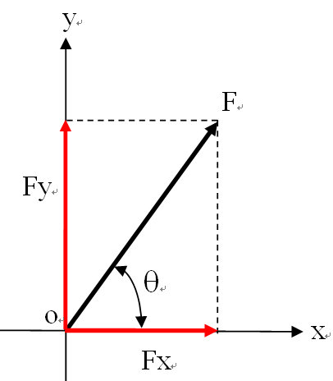
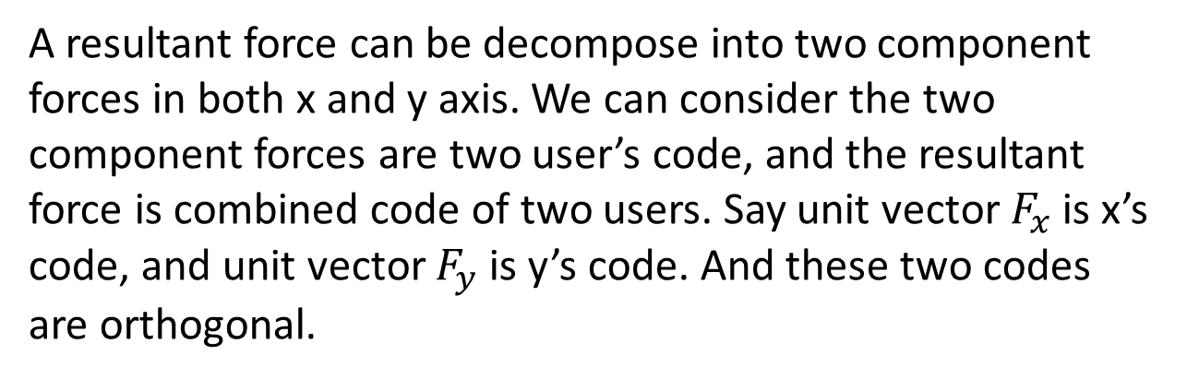
CDMA
Now, you may know what is code in CDMA. But how to make these code to minimize interference in multiple access?
The codes should be orthogonal.
To understand orthogonality of code.
Think about a vector in coordinate system.
A resultant force can be decompose into two component forces in both x and y axis. We can consider the two component forces are two user’s code, and the resultant force is combined code of two users. Say unit vector $F_{x}$ is x’s code, and unit vector $F_{y}$ is y’s code. And these two codes are orthogonal.

Slide 40
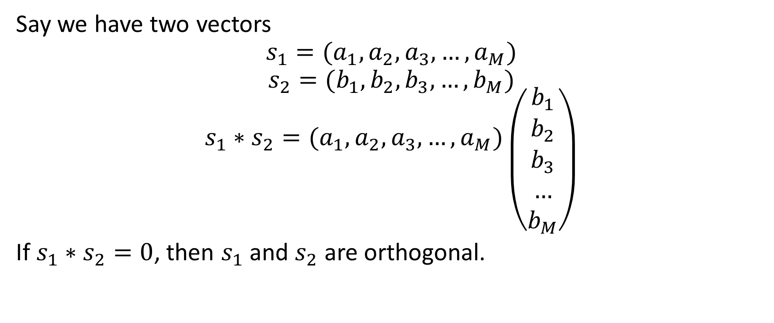
CDMA
Say we have two vectors
$$s_{1}=(a_{1},a_{2},a_{3},…,a_{M})$$
$$s_{2}=(b_{1},b_{2},b_{3},…,b_{M})$$
$$s_{1}∗s_{2}=(a_{1},a_{2},a_{3},…,a_{M})\left({b_{1} \atop \begin{aligned}b_{2} \\ b_{3} \\ … \\ b_{M}\end{aligned}}\right)$$
If $s_{1}∗s_{2}=0$, then $s_{1}$ and $s_{2}$ are orthogonal.

Slide 41
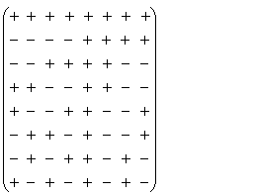
CDMA
How to get orthogonal vectors?
Walsh matrix
“+” is +1, “–” is -1, and in Walsh matrix,
any two rows or two columns are orthogonal.
Here for example we have an 8 Walsh matrix.
We use each row or column as a
spreading code.

Slide 42
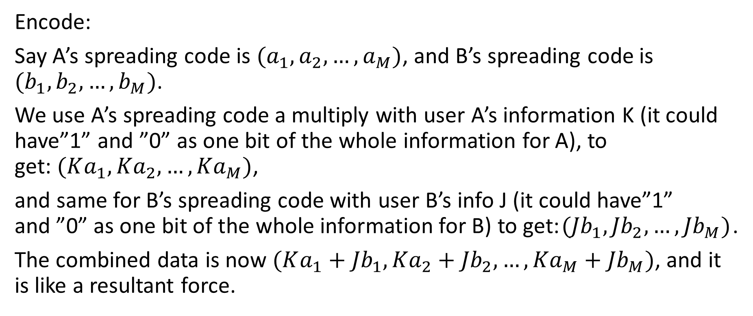
CDMA
Encode:
Say A’s spreading code is $(a_{1},a_{2},…,a_{M})$, and B’s spreading code is $(b_{1},b_{2},…,b_{M})$.
We use A’s spreading code a multiply with user A’s information K (it could have”1” and ”0” as one bit of the whole information for A), to get:$(Ka_{1},{Ka}_{2}, …,{Ka}_{M})$,
and same for B’s spreading code with user B’s info J (it could have”1” and ”0” as one bit of the whole information for B) to get:$({Jb}_{1},{Jb}_{2},…,{Jb}_{M})$.
The combined data is now $(Ka_{1}+{Jb}_{1},{Ka}_{2}+{Jb}_{2}, …,{Ka}_{M}+{Jb}_{M})$, and it is like a resultant force.

Slide 43
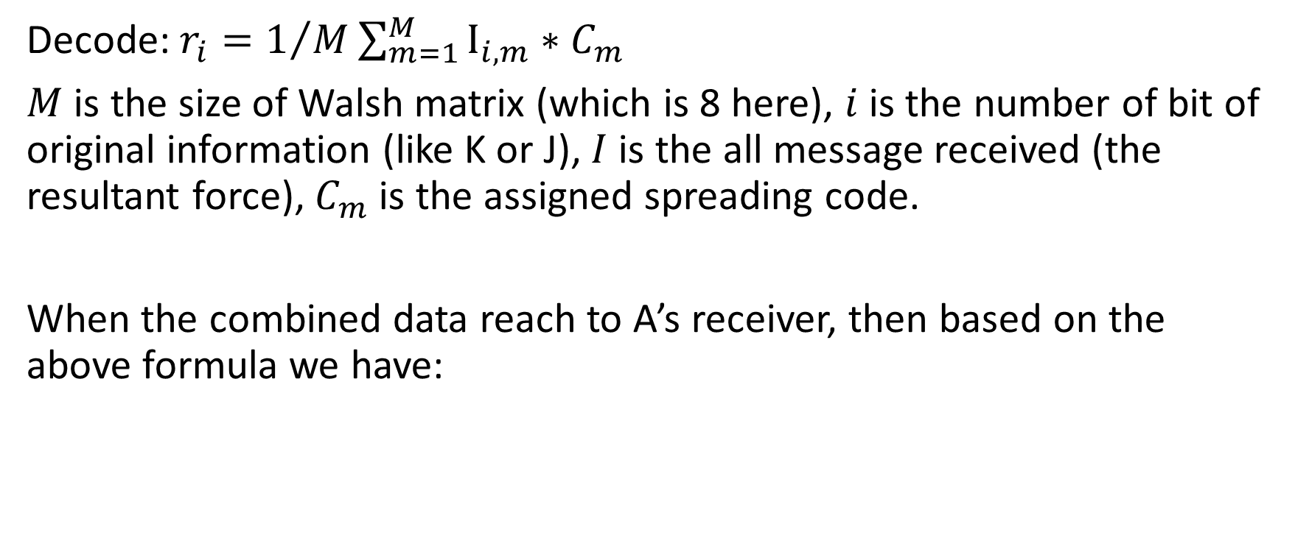
CDMA
Decode: $r_{i}=1/M\sum_{m=1}^{M}{I_{i,m}∗C_{m}}$
$M$ is the size of Walsh matrix (which is 8 here), $i$ is the number of bit of original information (like K or J), $I$ is the all message received (the resultant force), $C_{m}$ is the assigned spreading code.
When the combined data reach to A’s receiver, then based on the above formula we have:

Slide 44
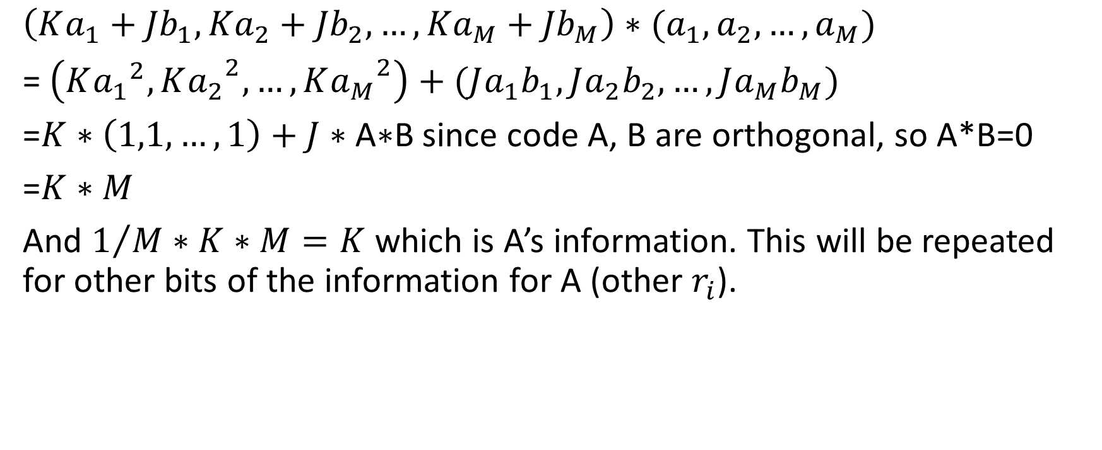
CDMA
$$\left(Ka_{1}+{Jb}_{1},{Ka}_{2}+{Jb}_{2}, …,{Ka}_{M}+{Jb}_{M}\right)∗(a_{1},a_{2},…,a_{M})$$
= $\left(K{a_{1}}^{2},{Ka_{2}}^{2}, …,{Ka_{M}}^{2}\right)+({Ja_{1}b}_{1},{Ja_{2}b}_{2},…,{Ja_{M}b}_{M})$
=$K∗\left(1,1,…,1\right)+J∗\text{A}\text{∗}\text{B}$ since code A, B are orthogonal, so A*B=0
=$K∗M$
And $1/M∗K∗M=K$ which is A’s information. This will be repeated for other bits of the information for A (other $r_{i}$).

Slide 45
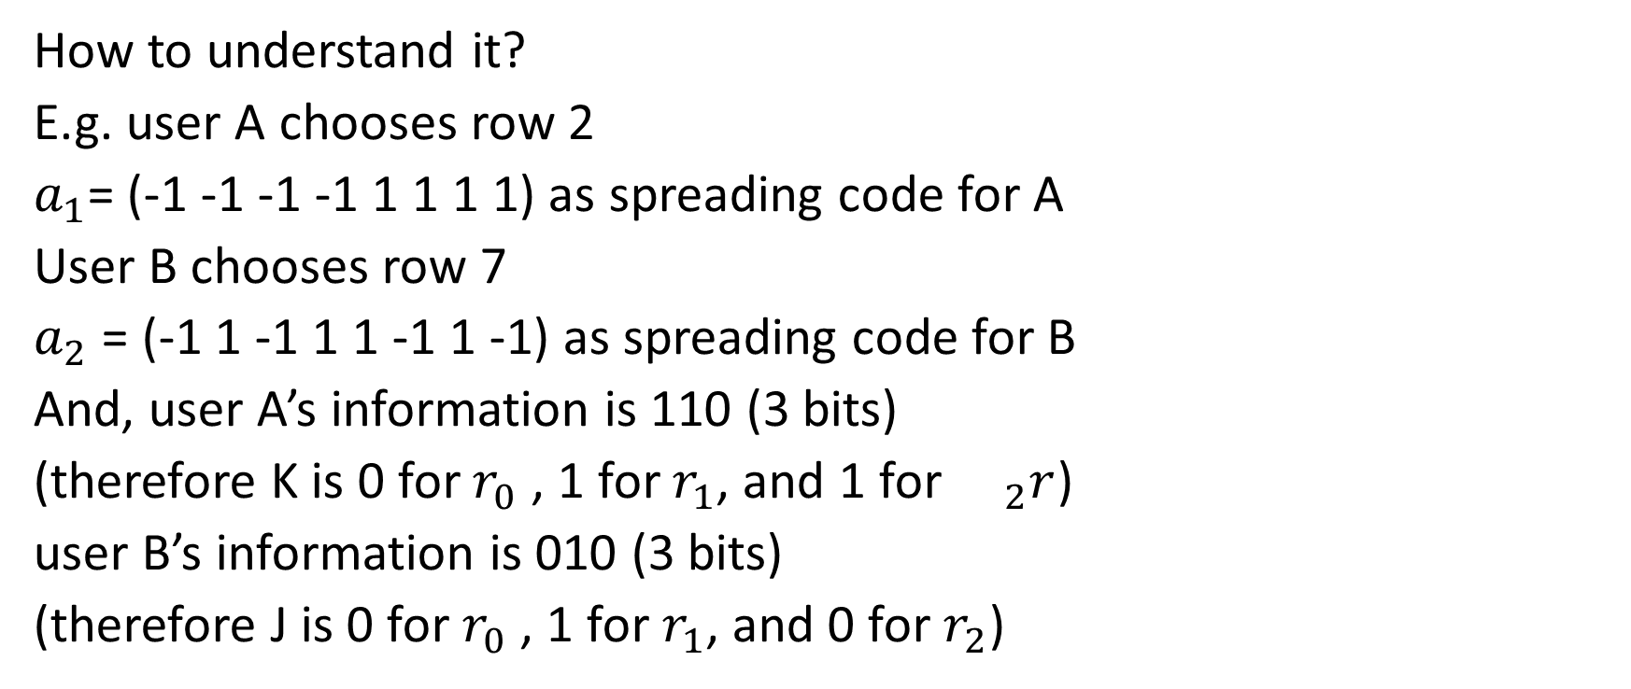
CDMA
How to understand it?
E.g. user A chooses row 2
$a_{1}$= (-1 -1 -1 -1 1 1 1 1) as spreading code for A
User B chooses row 7
$a_{2}$ = (-1 1 -1 1 1 -1 1 -1) as spreading code for B
And, user A’s information is 110 (3 bits)
(therefore K is 0 for $r_{0}$ , 1 for $r_{1}$, and 1 for ${}_{2}r$)
user B’s information is 010 (3 bits)
(therefore J is 0 for $r_{0}$ , 1 for $r_{1}$, and 0 for $r_{2}$)

Slide 46
CDMA
Encode (slide 41 three times):
Let’s encode user A’s message using
(-1 -1 -1 -1 1 1 1 1)|(-1 -1 -1 -1 1 1 1 1)|(0 0 0 0 0 0 0 0 0)
User B’s message:
(0 0 0 0 0 0 0 0 0)|(-1 1 -1 1 1 -1 1 -1)|(0 0 0 0 0 0 0 0 0)
And we combine these two message:
(-1 -1 -1 -1 1 1 1 1)|(-2 0 -2 0 2 0 2 0)|(0 0 0 0 0 0 0 0 0)
You can consider this is a resultant force.

Slide 47
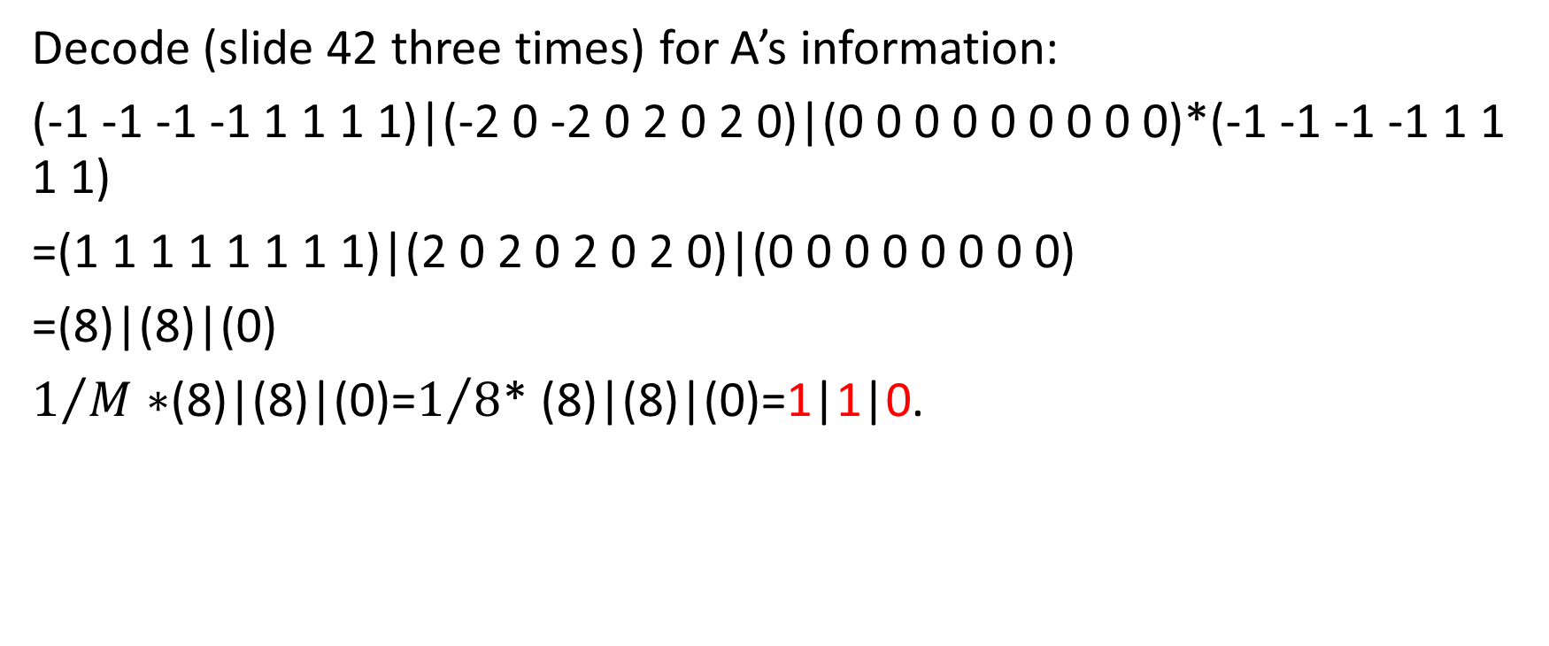
CDMA
Decode (slide 42 three times) for A’s information:
(-1 -1 -1 -1 1 1 1 1)|(-2 0 -2 0 2 0 2 0)|(0 0 0 0 0 0 0 0 0)*(-1 -1 -1 -1 1 1 1 1)
=(1 1 1 1 1 1 1 1)|(2 0 2 0 2 0 2 0)|(0 0 0 0 0 0 0 0)
=(8)|(8)|(0)
$1/M∗$(8)|(8)|(0)=$1/8$* (8)|(8)|(0)=1|1|0.

Slide 48
analog and digital modulation techniques
Both analog and digital modulation use smoothly varying signals; the difference is that an analog-modulated signal is demodulated into an analog baseband waveform, whereas a digitally modulated signal consists of discrete modulation units, called symbols, that are interpreted as digital data.

Slide 49
Pulse - width modulation
Pulse Width Modulation (PWM) or Pulse Duration Modulation (PDM) or Pulse Time Modulation (PTM) is an analog modulating scheme in which the duration or width or time of the pulse carrier varies proportional to the instantaneous amplitude of the message signal.
The width of the pulse varies in this method, but the amplitude of the signal remains constant. Amplitude limiters are used to make the amplitude of the signal constant. These circuits clip off the amplitude, to a desired level and hence the noise is limited.

Slide 50
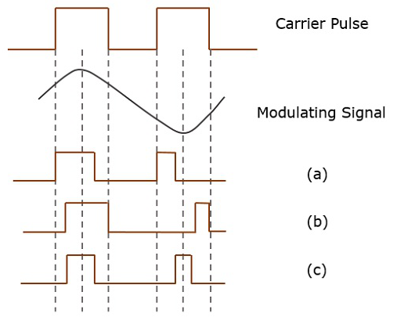
Pulse - width modulation
The following figures explain the types of Pulse Width Modulations.

Slide 51
Pulse - width modulation
There are three variations of PWM. They are −
The leading edge of the pulse being constant, the trailing edge varies according to the message signal.
The trailing edge of the pulse being constant, the leading edge varies according to the message signal.
The center of the pulse being constant, the leading edge and the trailing edge varies according to the message signal.
These three types are shown in the above given figure, with timing slots..

Slide 52
Pulse - code modulation
In pulse code modulation, as a digital modulation technique, a message signal is represented by a sequence of coded pulses, which is accomplished by representing the signal in discrete form in both time and amplitude.
Low pass filter
Sampler
Quantizer
Encoder
Source of continuous time signal
PCM signal

Slide 53
The receiver of PCM system
Regeneration circuit
Decoder
Reconstruction filter
Channel input
Destination

Slide 54
The receiver of PCM system
PCM – regeneration:
It is the most important feature of PCM system which is the ability to control the effects of distortion and noise produced by transmitting a PCM signal though a channel.

Slide 55
Why we need regeneration
The signal attenuation is proportional to the frequency. Recall the high frequency signal would be hard to go through the concrete building.

Slide 56
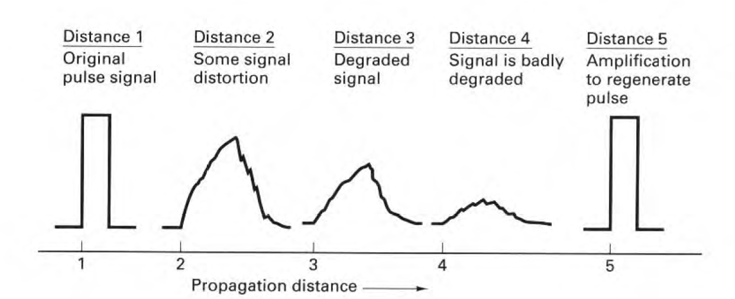
Why we need regeneration
Effects in distance as:
1. the amplitude of received signal pulse is reduced. Since there is attenuation in transmission line, the longer transmission distance, the higher attenuation, and the more obvious of amplitude decrease.
It is also affected by transmission distance.

Slide 57
Why we need regeneration
Effects in distance as:
2. wave peak is delayed, it is the delay characteristic of transmission.
3. The pulse width is increased, it is because of attenuation – frequency characteristic, that causes pulse wave distortion, and this distortion causes trailing, so ISI will happen.
It is also affected by transmission distance.

Slide 58
Why we need regeneration
And if we consider noise, the performance will be worse.
So, when the transmission distance increase to a certain range, the received pulse would be hard to identify.
We need a chain of regenerative repeaters to reconstruct the PCM signal.

Slide 59
Session – January 25

Slide 60
The receiver of PCM system
It is also called Regeneration circuit.
Three basic functions are performed by a regenerative repeater:
Amplifier equalizer
Decision making device
Distorted PCM wave
Regenerated PCM wave
Timing circuit
Regeneration circuit

Slide 61
The receiver of PCM system
The equalizer shapes the received pulses so compensate (correct) for the effects of amplitude and phase distortions.
The timing circuit provide a periodic pulse train, derived from the received pulses, for sampling the equalized pulses at the instants of time.
In decision – making device, there is a predetermined threshold, by comparing the sample with “threshold” to make whether the received symbol should be considered as “1” or “0”.

Slide 62
The receiver of PCM system
The key function is equalizer, where can add a compensate wave in time domain equalizer. For example, to reduce the effect of ISI (interference terms), we can add pulse waves having same wave form and opposite polarity of trailing.
ISI tail
compensate wave

Slide 63
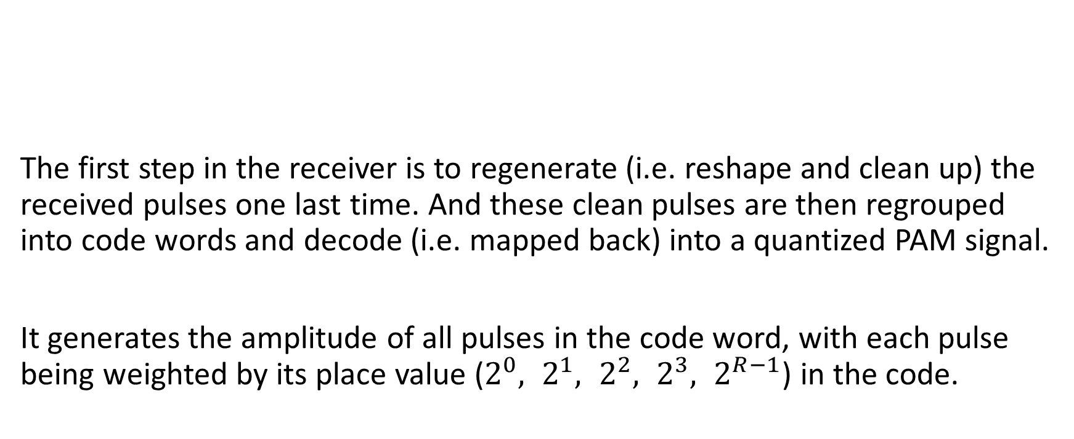
The end of receiver
Decoder
Reconstruction filter
The first step in the receiver is to regenerate (i.e. reshape and clean up) the received pulses one last time. And these clean pulses are then regrouped into code words and decode (i.e. mapped back) into a quantized PAM signal.
It generates the amplitude of all pulses in the code word, with each pulse being weighted by its place value ($2^{0}, 2^{1}, 2^{2}, 2^{3}, 2^{R−1}$) in the code.
Regeneration circuit
Distorted PCM wave
Destination

Slide 64
The receiver of PCM system
Filtering: to recover the message signal wave by passing a low – pass reconstruction filter whose cutoff frequency is equal to the message bandwidth W.

Slide 65
Error correction
Techniques that enable reliable delivery of digital data over unreliable communication channels.
Two different ways
1. Automatic report request (ARQ)
2. Forward error correction (FEC)

Slide 66
Automatic report request (ARQ)
An error detection scheme combined with an error control technique, it requests for retransmission of error data.
A. stop - and - wait
After sending each frame, the sender doesn't send any frames further until it receives an acknowledgement (ACK) from receiver. If sender doesn't receive ACK before a certain time, known as time out, the sender will resend the same frame again and keep waiting.

Slide 67
Automatic report request (ARQ)
B. GO - Back - N: The sender sends out all frames without waiting, and if receiver gets an undesired frame N, it will discard all the frames after frame N-1 and replies ACK N-1. Then sender will resend all frames in order started at frame N.
C. selective repeat: The receiver sends back all ACKs for every frame, once sender doesn't get ACK N, it will resend frame N only.

Slide 68
Forward error correction (FEC)
Also known as channel coding. The sender sends redundant data and the receiver recognizes only the portion of the data that contains no apparent errors.
In the simplest form of FEC, each character is sent twice (in Triple modular redundancy, each character is sent 3 times, etc).
Meanwhile, the sender encoded each instance of the character by adding check bits in two ways:

Slide 69
Forward error correction (FEC)
Systematic code is any error - correcting code in which the original input data is embedded in the encode output.
In non - systematic code, the output does not contain the original input symbols.
Example:
Input info bit (a0, a1, a2, a3) check bit (b1, b2)
Output: A (a0, a1, a2, a3, b1, b2) as symmetric code, and B (a0, b1, a1, b2, a2, a3) as non-symmetric code

Slide 70
Forward error correction (FEC)
On the other hand, the receiver checks all instances of each character for adherence to the protocol being used. If conformity occurs, the code is accepted otherwise rejected.
If conformity occurs in none of instances, then the character is completely rejected and a blank space or an underscore is displayed in its place.

Slide 71
Communications security and the importance of security in machine to machine and device to device communication.

Slide 72
Purpose of communications security
Communications and network security are fundamental to our modern life. The Internet, the World Wide Web, online banking, instant messaging, email, and many other technologies rely on network security; our modern world cannot exist without it. Communications and network security focuses on the confidentiality, integrity, and availability of data in motion.
Communications security (COMSEC) can be defined as follows:
Measures and controls taken to deny unauthorized persons information derived from telecommunications and to ensure the authenticity of such telecommunications. Communications security includes crypto-security [i.e., encryption or decryption], transmission security, emission security [i.e., intercept and analysis of emanations from equipment], and physical security of COMSEC material.

Slide 73
Communication security
Authentication and Authorization
Authentication is the process of verifying that somebody really is who they claim to be.
In short: login + password (who you are)
Authorization is the process of verifying you are allowed to do something.
In short: permissions (what you are allowed to do)

Slide 74
Authorization Techniques
As we mentioned before while Authentication refers to proving correct identity, Authorization refers to allowing a certain action. Authorization should be used whenever you want to control viewer access of certain pages. For example, college students are not authorized to view certain web pages dedicated to professors and administration. The authorization requirements for a site are typically defined in a website's .htaccess file.
There are several methods for authorization. For example, for API services, the following are various types of authorization you might encounter:
API keys
Basic Auth
HMAC
OAuth

Slide 75
Authorization Techniques
API:
API is the acronym for Application Programming Interface which is a software intermediary that allows two applications to talk to each other.
Each time you use an app like Facebook, send an instant message, or check the weather on your phone, in fact you are using an API.

Slide 76
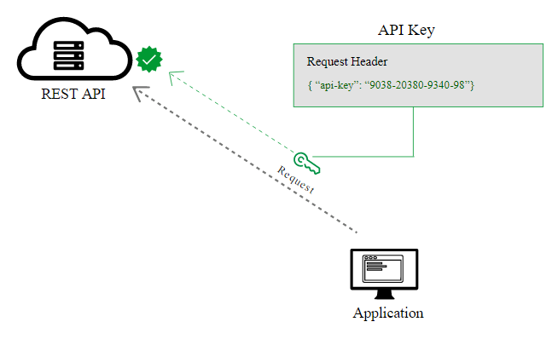
Authorization Techniques
API keys
Most APIs require you to sign up for an API key in order to use the API. The API key is a long string that you usually include either in the request URL or request header. The API key mainly functions as a way to identify the person making the API call (authenticating you to use the API). The API key might also be associated with a specific app that you register.

Slide 77
Authorization Techniques
Basic Auth
Another type of authorization is called Basic Auth. With this method, the sender places a username:password into the request header. The username and password are encoded with Base64, which is an encoding technique that converts the username and password into a set of 64 characters to ensure safe transmission. Here’s an example of a Basic Auth in a request header:
Authorization: Basic bG9sOnNlY3VyZQ==
APIs that use Basic Auth will also use HTTPS, which means the message content will be encrypted within the HTTP transport protocol. (Without HTTPS, it would be easy for people to decode the username and password.)

Slide 78
Authorization Techniques
HMAC (Hash-based message authorization code)
HMAC stands for Hash-based message authorization code and is a stronger type of authorization, more common in financial APIs. With HMAC, both the sender and receiver know a secret key that no one else does. The sender creates a message based on some system properties (for example, the request timestamp plus account ID).
The message is then encoded by the secret key and passed through a secure hashing algorithm (SHA). (A hash is a scramble of a string based on an algorithm.) The resulting value, referred to as a signature, is placed in the request header.
When the receiver (the API server) receives the request, it takes the same system properties (the request timestamp plus account ID) and uses the secret key (which only the requester and API server know) and SHA to generate the same string. If the string matches the signature in the request header, it accepts the request. If the strings don’t match, then the request is rejected.

Slide 79
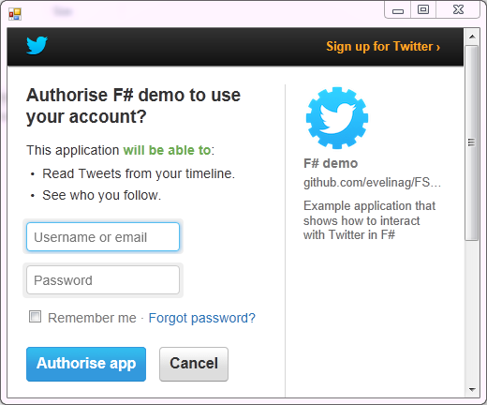
Authorization Techniques
OAuth
One popular method for authorizing users is OAuth, especially OAuth2.0. This approach relies on an authentication server to communicate with the API server to grant access. You often see OAuth 2.0 when you’re using a site and are prompted to log in using a service like Twitter, Google, or Facebook.

Slide 80
Authentication Techniques
There are many types of authentication but here we can mention a couple of them:
Password-based authentication
Multi-factor authentication
Certificate-based authentication
Biometric authentication
Token-based authentication

Slide 81
Authentication Techniques
Password-based authentication
Passwords are the most common methods of authentication. Passwords can be in the form of a string of letters, numbers, or special characters. To protect yourself you need to create strong passwords that include a combination of all possible options. However, passwords are prone to phishing attacks and bad hygiene that weakens effectiveness. An average person has about 25 different online accounts, but only 54% of users use different passwords across their accounts.
The truth is that there are a lot of passwords to remember. As a result, many people choose convenience over security. Most people use simple passwords instead of creating reliable passwords because they are easier to remember.
The bottom line is that passwords have a lot of weaknesses and are not sufficient in protecting online information. Hackers can easily guess user credentials by running through all possible combinations until they find a match.

Slide 82
Authentication Techniques
Multi-factor authentication
Multi-Factor Authentication (MFA) is an authentication method that requires two or more independent ways to identify a user. Examples include codes generated from the user’s smartphone, Captcha tests, fingerprints, or facial recognition.
MFA authentication methods and technologies increase the confidence of users by adding multiple layers of security. MFA may be a good defense against most account hacks, but it has its own pitfalls. People may lose their phones or SIM cards and not be able to generate an authentication code.

Slide 83
Authentication Techniques
Certificate-based authentication
Certificate-based authentication technologies identify users, machines or devices by using digital certificates. A digital certificate is an electronic document based on the idea of a driver’s license or a passport.
The certificate contains the digital identity of a user including a public key, and the digital signature of a certification authority. Digital certificates prove the ownership of a public key and issued only by a certification authority.
Users provide their digital certificates when they sign in to a server. The server verifies the credibility of the digital signature and the certificate authority. The server then uses cryptography to confirm that the user has a correct private key associated with the certificate.

Slide 84
Authentication Techniques
Biometric authentication
Biometrics authentication is a security process that relies on the unique biological characteristics of an individual. Here are key advantages of using biometric authentication technologies:
Biological characteristics can be easily compared to authorized features saved in a database. Biometric authentication can control physical access when installed on gates and doors. You can add biometrics into your multi-factor authentication process. Biometric authentication technologies are used by consumers, governments and private corporations including airports, military bases, and national borders. Common biometric authentication methods include: facial recognition, fingerprint scanners, voice identification, and eye scanners

Slide 85
Authentication Techniques
Token-based authentication
Token-based authentication technologies enable users to enter their credentials once and receive a unique encrypted string of random characters in exchange. You can then use the token to access protected systems instead of entering your credentials all over again. The digital token proves that you already have access permission. Use cases of token-based authentication include RESTful APIs that are used by multiple frameworks and clients.

Slide 86
Encryption
Encryption is a process that encodes a message or file so that it can be only be read by certain people. Encryption uses an algorithm to scramble, or encrypt, data and then uses a key for the receiving party to unscramble, or decrypt, the information. The message contained in an encrypted message is referred to as plaintext. In its encrypted, unreadable form it is referred to as ciphertext.
Basic forms of encryption may be as simple as switching letters. As cryptography advanced, cryptographers added more steps, and decryption became more difficult. Wheels and gears would be combined to create complex encryption systems. Computer algorithms have now replaced mechanical encryption..

Slide 87
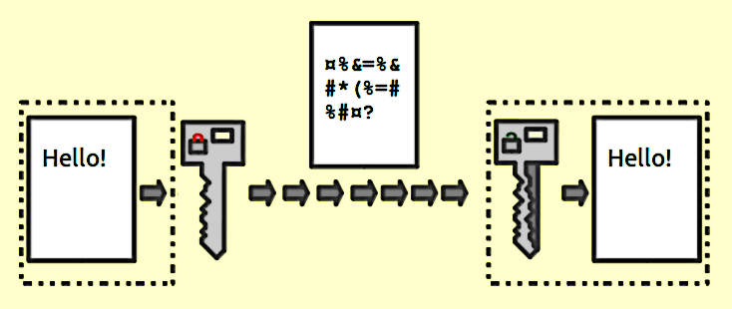
Encryption
In encryption there might be a public key and a private key. And they are related mathematically. Normally, we use public key to encrypt message, and private key to decrypt (But in authentication, user use private key to encrypt, and server use public key to decrypt, if decryption succeed, wa say that user is an authenticated user.)

Slide 88
Encryption
A popular encryption algorithm: Caesar cipher, one of the simplest and most widely known encryption techniques.
In Caesar cipher, we choose an integer K as our key, and we shift or rotate alphabet k place to get a cipher alphabet.

Slide 89
Encryption
Say k = 3.
Alphabet: a b c d e f g h I j k l m n o p q r s t u v w x y z
x y z a b c d e f g h I j k l m n o p q r s t u v w
In decryption, user shift/rotate k place back.
Is Caesar cipher symmetric or asymmetric? You should be able to answer
Cipher alphabet (rotate 3 place):

Slide 90
Cryptography
Cryptography is the study of secure communications techniques that allow only the sender and intended recipient of a message to view its contents. The term is derived from the Greek word kryptos, which means hidden. It is closely associated to encryption, which is the act of scrambling ordinary text into what's known as ciphertext and then back again upon arrival. In addition, cryptography also covers the obfuscation of information in images using techniques such as microdots or merging.

Slide 91
Cryptography
Symmetric cryptography:
You would have a single password to lock your information and send it then. The receiver should use the same password to unlock the information.
Say user A and B want to communicate, A sends message to B.
1. A encrypts a text message with key K1 to get an encrypted message C1.
2. A sends key K1 to B
3. A sends message C1 to B.
4. B uses K1 to decrypt C1, and gets A’s text message.

Slide 92
Cryptography
Asymmetric cryptography:
The Public and Private key pair comprise of two uniquely related cryptographic keys (basically long random numbers). Below is an example of a Public Key:
3048 0241 00C9 18FA CF8D EB2D EFD5 FD37 89B9 E069 EA97 FC20 5E35 F577 EE31 C4FB C6E4 4811 7D86 BC8F BAFA 362F 922B F01B 2F40 C744 2654 C0DD 2881 D673 CA2B 4003 C266 E2CD CB02 0301 0001
The Public Key is what its name suggests - Public. It is made available to everyone via a publicly accessible repository or directory. On the other hand, the Private Key must remain confidential to its respective owner (Comodo - SSL Certificate Authority)

Slide 93
Cryptography
Asymmetric cryptography:
Because the key pair is mathematically related, whatever is encrypted with a Public Key may only be decrypted by its corresponding Private Key and vice versa.
For example, if Bob wants to send sensitive data to Alice, and wants to be sure that only Alice may be able to read it, he will encrypt the data with Alice's Public Key. Only Alice has access to her corresponding Private Key and as a result is the only person with the capability of decrypting the encrypted data back into its original form.
As only Alice has access to her Private Key, it is possible that only Alice can decrypt the encrypted data. Even if someone else gains access to the encrypted data, it will remain confidential as they should not have access to Alice's Private Key.

Slide 94
Cryptography
Asymmetric cryptography:
1. B has a mathematical paired key K1a and K1b, K1a is for encrypt and K1b is for decrypt.
2. B sends key K1a to A.
3. A uses K1a to encrypt his text message, gets encrypted message C1.
4. A sends C1 to B.
5. B uses key k1b to decrypt, and gets A’s text message.

Slide 95
Cryptography
Classic Cryptography | Modern Cryptography
It manipulates traditional characters, i.e., letters and digits directly. | It operates on binary bit sequences.
It is mainly based on ‘security through obscurity’. The techniques employed for coding were kept secret and only the parties involved in communication knew about them. | It relies on publicly known mathematical algorithms for coding the information. Secrecy is obtained through a secrete key which is used as the seed for the algorithms. The computational difficulty of algorithms, absence of secret key, etc., make it impossible for an attacker to obtain the original information even if he knows the algorithm used for coding.
It requires the entire cryptosystem for communicating confidentially. | Modern cryptography requires parties interested in secure communication to possess the secret key only.

Slide 96
Cryptography
Classic Cryptography like Casear encryption that explained before.
Modern symmetric cryptography like DES (Data Encryption Standard), and AES (Advanced Encryption Standard). Modern asymmetric cryptography, like RSA (Rivest–Shamir–Adleman).
Modern asymmetric cryptography is more secure than symmetric cryptography, but symmetric cryptography takes less time to encrypt. We will describe RSA in much more details soon.

Slide 97
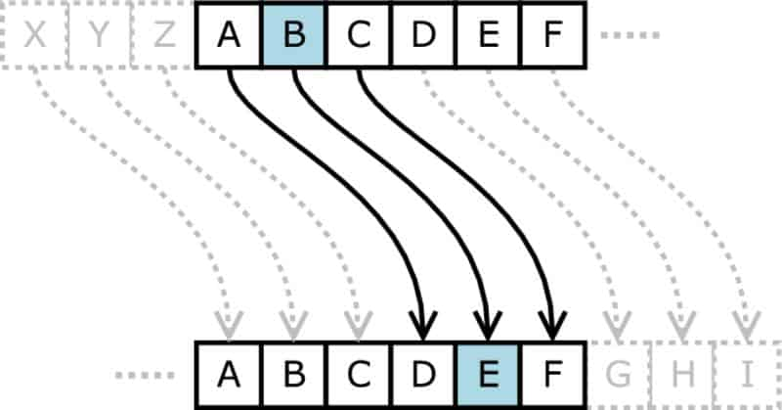
AES
AES encryption is the most widely used standard around the world. Unless you are really into this techno-geek stuff, you probably aren’t sure what that is even if you’re using it right now.

Slide 98
AES
Keys are used for encrypting and decrypting data. Because AES is a symmetric cipher, the same key may be used to both encrypt and decrypt information. Our original information is divided into several 128-bit long blocks called the plaintext. The plaintext can be considered as 16 bytes placed in a 4X 4 matrix of bytes. The matrix elements are called the “states” by experts.
The secret key size determines how many “rounds” are required to put a plaintext entry through the cipher, thereby converting it to ciphertext.
A 128-bit key requires 10 rounds while a 192-bit key requires 12 rounds. A full 14 rounds are required when a 256-bit key is being used. The longer the key, the more secure encryption. The trade-off is that the encryption will take much more time.

Slide 99
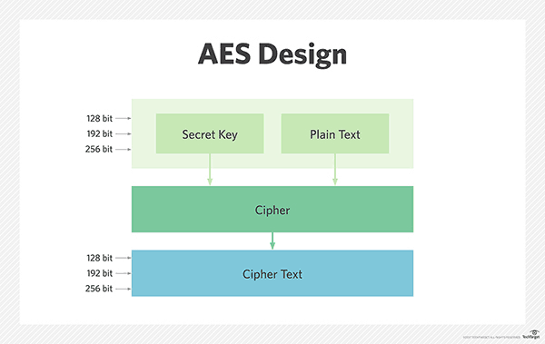
AES
AES relies on a block cipher algorithm to safely encrypt sensitive data.

Slide 100
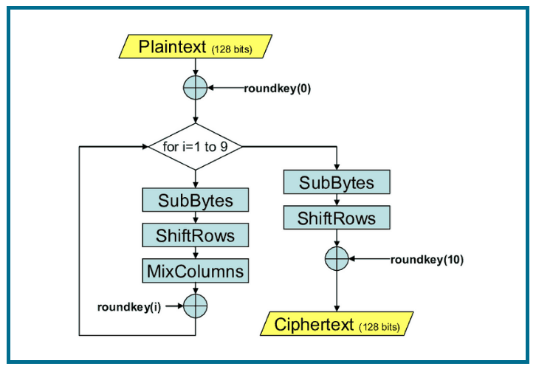
AES

Slide 101
AES
The diagram shows how AES works.
At first, the secret key will be added to the plaintext. By addition we mean XOR operation (roundkey(0)).
Then the result goes into a loop of blending (rounds) including SubBytes, ShiftRows, MixColumns, and internal secret key addition (One volunteer student is encouraged to explain about these four operations next session!).
For the last round we skip MixColumn plus we add the same secret key again to create the cibertext finally.

Slide 102
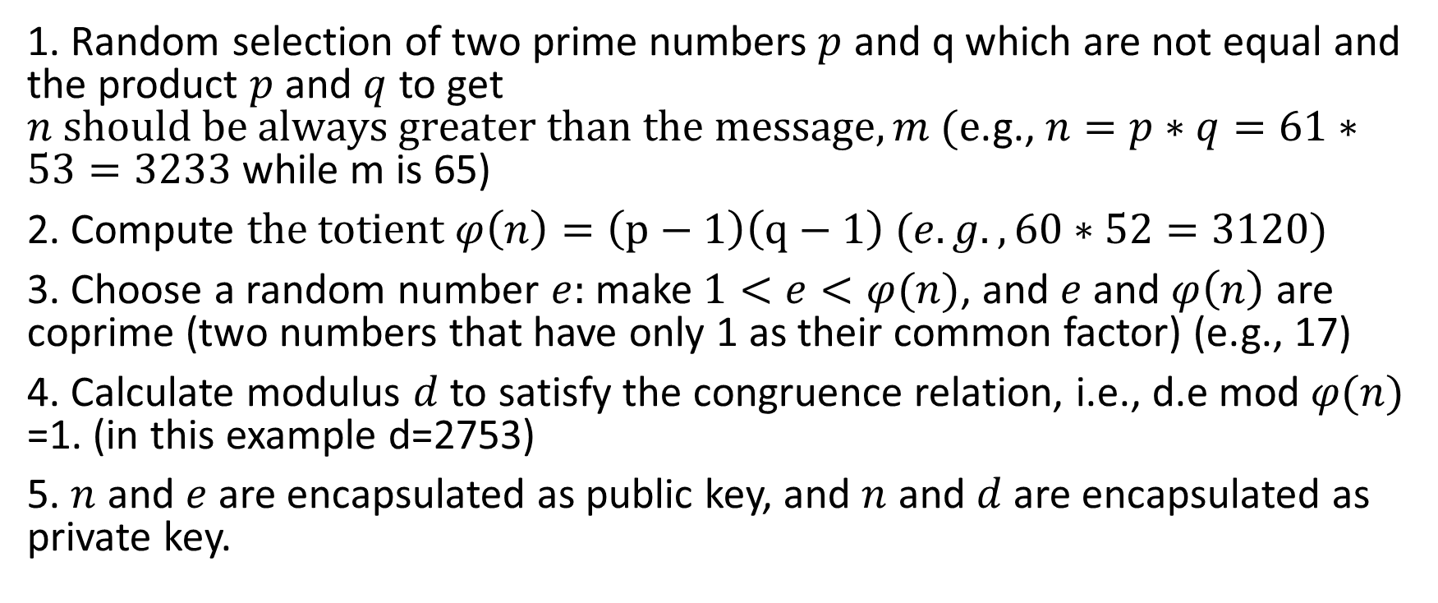
RSA
1. Random selection of two prime numbers $p$ and q which are not equal and the product $p$ and $q$ to get $n should be always greater than the message, m (e$.g., $n=p∗q=61∗53=3233$ while m is 65)
2. Compute $the totient φ\left(n\right)=\left(p−1\right)\left(q−1\right) (e.g.,60∗52=3120)$
3. Choose a random number $e:$ make $1<e<φ(n)$, and $e$ and $φ\left(n\right)$ are coprime (two numbers that have only 1 as their common factor) (e.g., 17)
4. Calculate modulus $d$ to satisfy the congruence relation, i.e., d.e mod $φ(n)$ =1. (in this example d=2753)
5. $n$ and $e$ are encapsulated as public key, and $n$ and $d$ are encapsulated as private key.

Slide 103
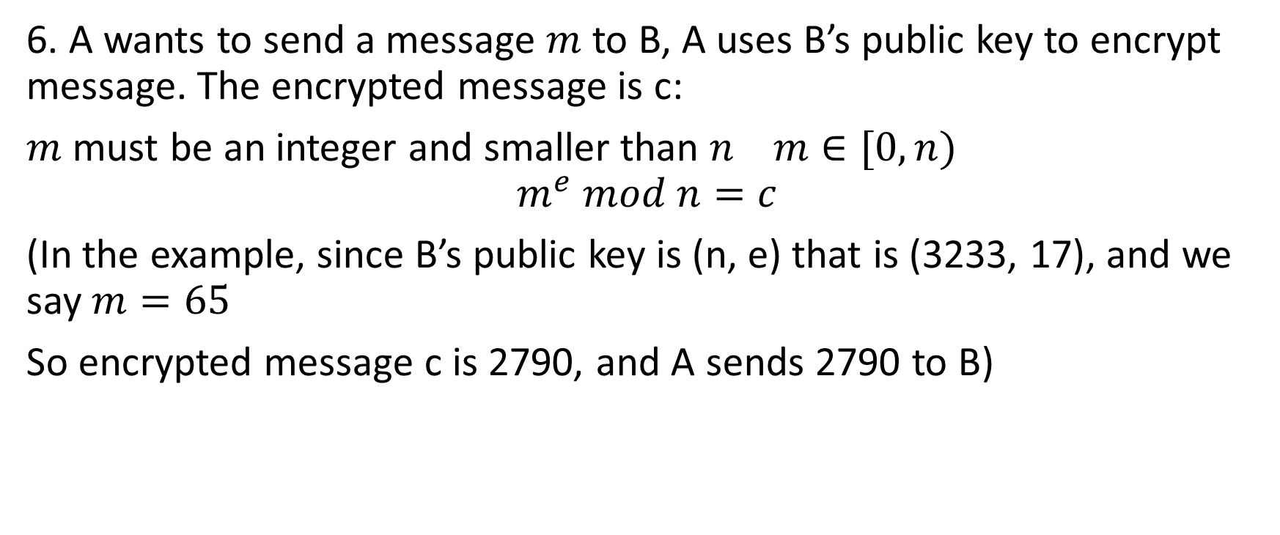
RSA
6. A wants to send a message $m$ to B, A uses B’s public key to encrypt message. The encrypted message is c:
$m$ must be an integer and smaller than $n m∈[0,n)$
$$m^{e} mod n=c$$
(In the example, since B’s public key is (n, e) that is (3233, 17), and we say $m=65$
So encrypted message c is 2790, and A sends 2790 to B)

Slide 104
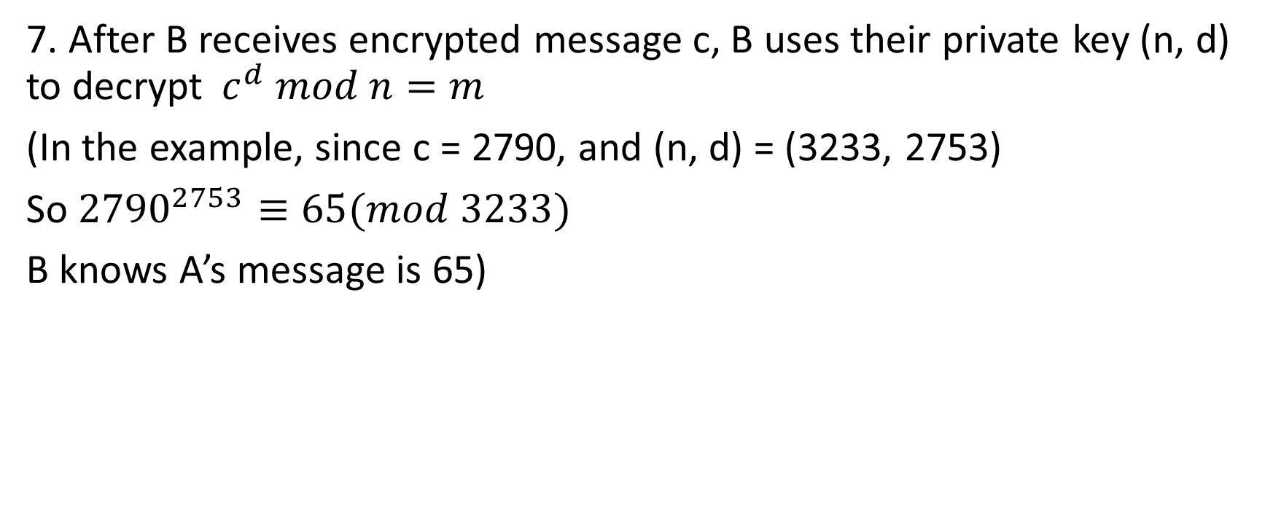
RSA
7. After B receives encrypted message c, B uses their private key (n, d) to decrypt$c^{d} mod n=m$
(In the example, since c = 2790, and (n, d) = (3233, 2753)
So ${2790}^{2753}≡65(mod 3233)$
B knows A’s message is 65)

Slide 105
RSA
So if we don’t know d, then we can not get m (message) from c (encrypted message). And to know d, we must factorize n. Because factorization a huge number n is extremely hard, RSA algorithm ensures the security of communication.
You may ask public key (n, e) an only encrypt message m < n, then how about we want to encrypt a message bigger than n?

Slide 106
RSA
Two ways:
1. The long information divided into several section of short message, and encrypt them respectively.
2. Use a symmetry encryption algorithm, like DES and then use RSA public key to encrypt DES encrypted message.

Slide 107
MITM: An Instance of Communication Security Importance
Man in the middle attack (MITM)
The attacker secretly relays and possibly alters the communication between two parties who believe they are directly communicating with each other.
A's key
A
B
B's key
A's key
C's key
C's key
B's key
C

Slide 108
MITM: An Instance of Communication Security Importance
1. A sends a message to B, which is intercepted by C:
A "Hi B, it is A, please give me your key" → C B
2. C relays this message to B, and B can't tell it is not real from A:
A C "Hi B, it is A, please give me your key" → B
3. B responds with his encryption key:
A C ← [B's key] B

Slide 109
MITM: An Instance of Communication Security Importance
4. C replaces B's key with his own key, and relays it to A, claiming it is B's key:
A ← [C's key] C B
5. A encrypts a message with A believes to be B's key, thinking that only B can read it:
A "Meet me at the bus station" → C B
6.However, since it was actually encrypted with C's key, C can decrpyt it, and even modify it by re-encrypting with B's key, and forward to B:
A C "Meet me at the van in backstreet" → B

Slide 110

How to prevent MITM?

Slide 111
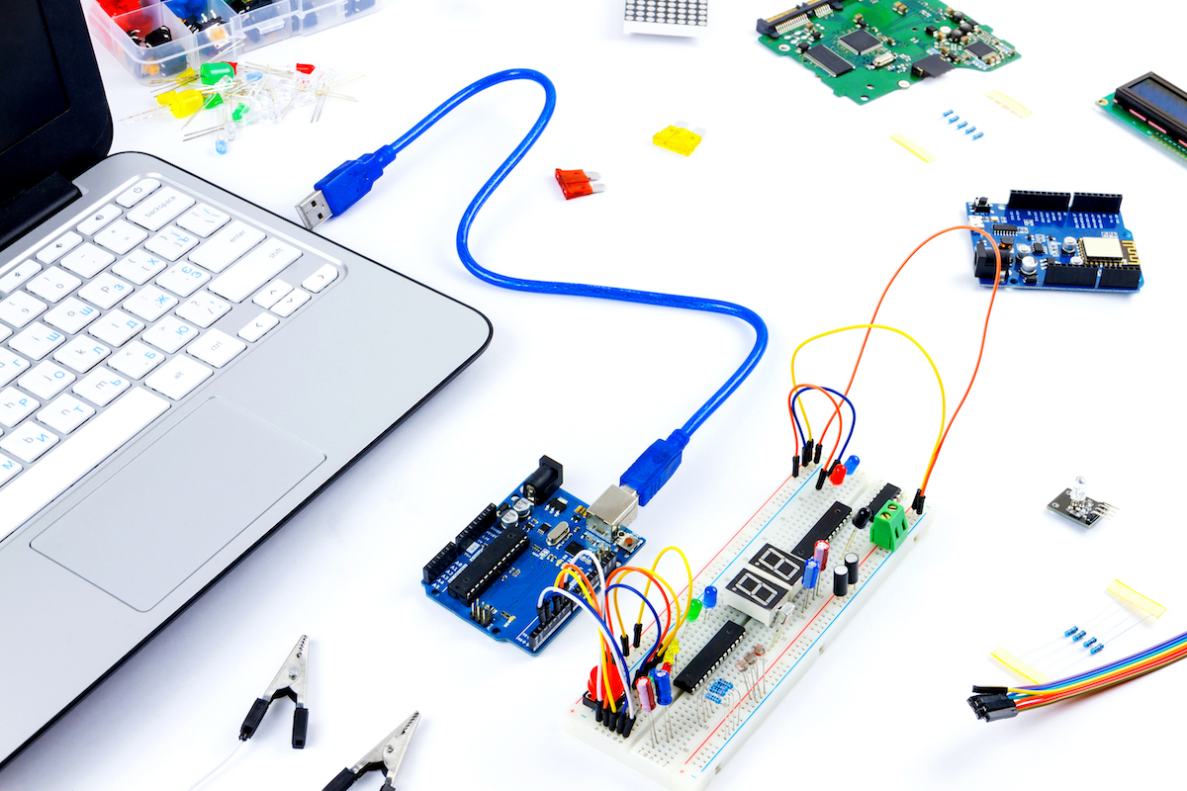
Have you already prepared the Components?

Slide 112
Session – February 1

Slide 113
Have you already prepared the Components?

Slide 114
ESE 3014 the I2C protocol and establishing communications between devices using I2C

Slide 115
Bus communication
Bus interface on BBB: it is a mechanism that enables data to be transferred between the high-level components of an embedded platform, using standardized communication protocols.
Two common embedded system synchronous bus communication are:
I2C (Inter-Integrated Circuit)
SPI (Serial peripheral Interface)

Slide 116
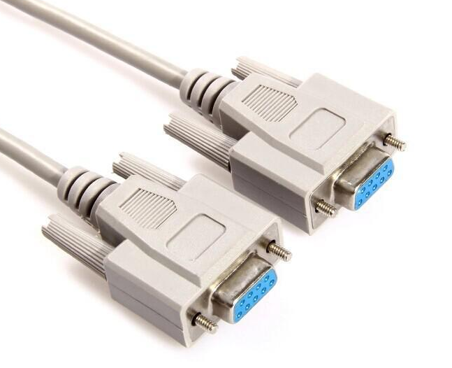
Bus communication
One more: UART (Universal Asynchronous Receiver/Transmitter), it can implement standard serial communications protocol, such as RS-232, RS-422, or RS-485.

Slide 117
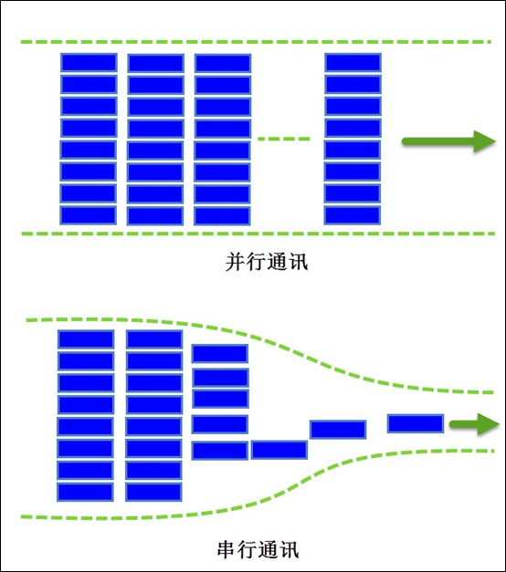
Bus communication
According to the mode of data transmission, it can be divided into the following two types:
1. Serial transmission bus
2. Parallel transmission bus
Serial transmission is like a car or a person taking one path at a time.
What is parallel transmission? it is multiple cars or multiple people taking multiple paths at the same time.
Parallel transmission
Serial transmission

Slide 118
Bus communication
In terms of efficiency, the efficiency of parallel transmission must be higher than serial transmission . But Parallel transmission consumes far more resources than serial transmission. Serial transmission of one line (MCU with one IO) can complete the transmission of multiple bits, but it takes a long time, which is a disadvantage. Parallel transmission requires multiple lines (MCU uses multiple IOs) to send multiple bits, but the corresponding time is saved. Therefore, in general, parallel communication is suitable for short distance transmission, usually less than 30m, while serial communication is more suitable for long distance transmission, ranging from a few meters to thousands of kilometers.

Slide 119

Bus communication
From the data communication direction, bus communication will be divided into simplex, half duplex, full duplex.
1. Simplex: only one direction of communication can be carried out at any time, that is, one is fixed as sending device and the other is fixed as receiving device.

Slide 120
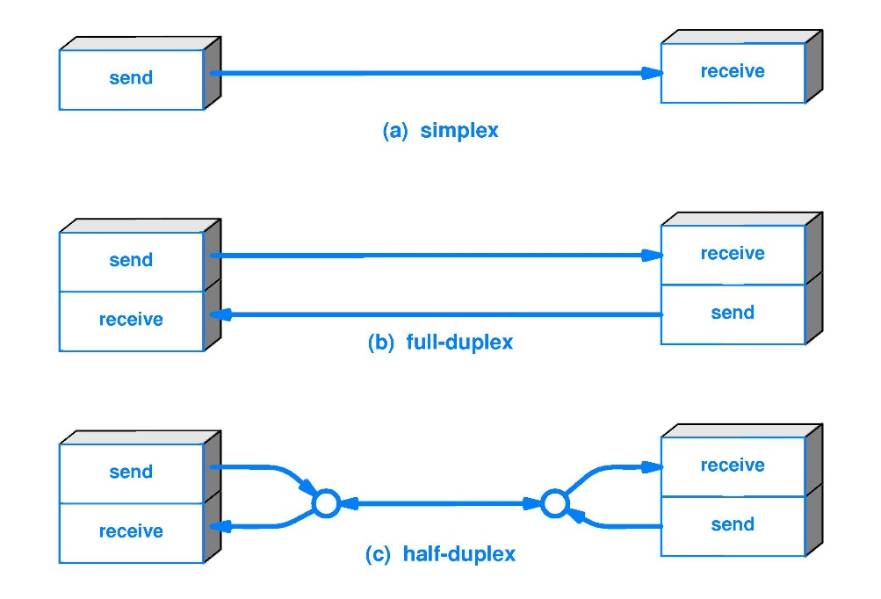
Bus communication
2. Half duplex: data can be sent and received between two devices, but not at the same time.
3. Full duplex: data can be sent and received between two devices at the same time.

Slide 121
Bus communication
The process of transmission, according to the way of data transmission, can be divided into synchronous and asynchronous.
1. Synchronous, literally, means that both parties are doing the same thing at the same time, In communication, from the start of the clock line to the end, the data line must follow the frequency of the clock transmission.
2. Asynchronous, relative to the synchronous, asynchronous don't need a common clock on both sides, namely the receiver don't know when the sender to send, so need to be prompted to the receiver to receive the information, such as start bit, at the time when it starts, and stop bit when it is over.

Slide 122
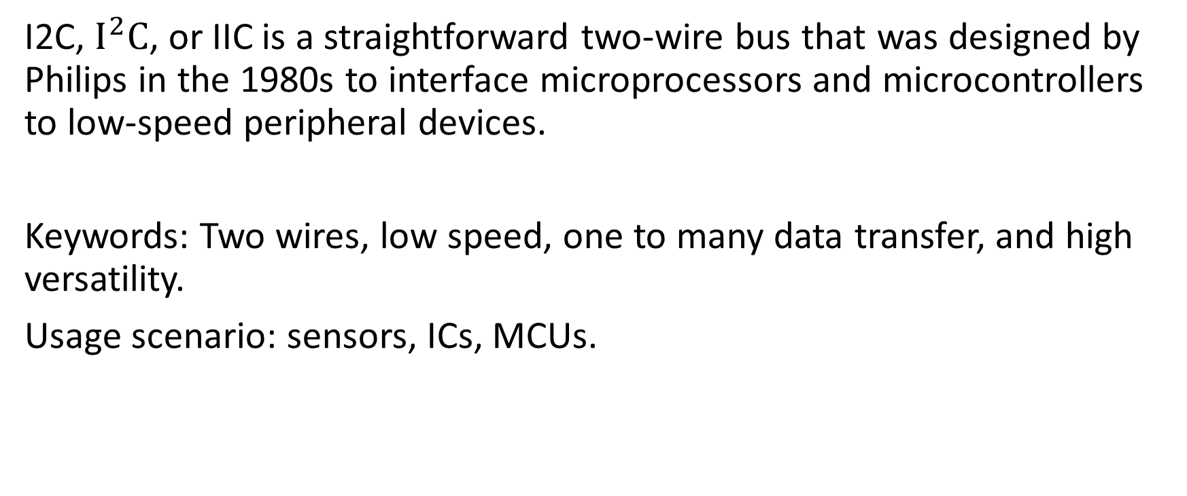
I2C
I2C, $I^{2}C$, or IIC is a straightforward two-wire bus that was designed by Philips in the 1980s to interface microprocessors and microcontrollers to low-speed peripheral devices.
Keywords: Two wires, low speed, one to many data transfer, and high versatility.
Usage scenario: sensors, ICs, MCUs.

Slide 123
I2C
Some features of I2C
1. Only two signal lines are required for communication.
The serial Data (SDA) line for the bidirectional transmission of data.
The serial Clock (SCL) line, is used to synchronize the data transfer.
So SDA wire can be used for sending and receiving data with synchronizing clock.

Slide 124
I2C
2. Each device on the bus can act as a master or a slave.
The master device(e.g. BBB) is the one that initiates communication and the slave(e.g. ADXL345 accelerometer) is the one that responds. Designated slave devices can not initiate communication with the master device.
3. Each slave device attached to the bus is pre-assigned a unique address which is in either 7-bit or 10-bit form.

Slide 125
I2C
Instead of UART (Universal Asynchronous Receiver/Transmitter) WHICH has one to one communication, I2C can achieve one to many. It can extend the interface with software simulation, (but cannot seen with UART). The biggest reason for its talent is simplicity and flexibility.
A master device controls the bus and many addressable slave devices (such as many sensors) can be attached to the same two wires.

Slide 126
I2C
In 7-bit unique address, the 4 high bit is for device type, which is made by the manufacturer. The 3 low bit is definition address of device pin, defined by user. Master device uses the address code to set up multi-device communication mechanism, so I2C saves chip select line for peripheral devices. The devices with different logic families can be intermixed on the bus, and a large number of devices can be added to a single bus. Up to 128 devices could be attached to a single bus in theory. Why?

Slide 127
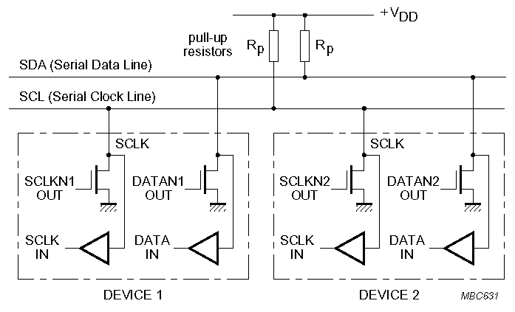
I²C Electrical Aspects
I²C devices are wire ANDed together.
If any single node writes a zero, the entire line is zero

Slide 128
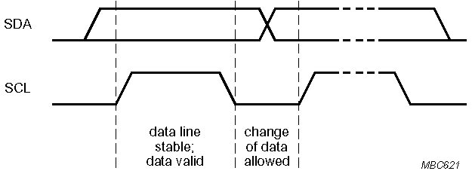
Bit Transfer on the I²C Bus
In normal data transfer, the data line only changes state when the clock is low
SDA
SCL
Data line stable; Data valid
Change of data allowed

Slide 129
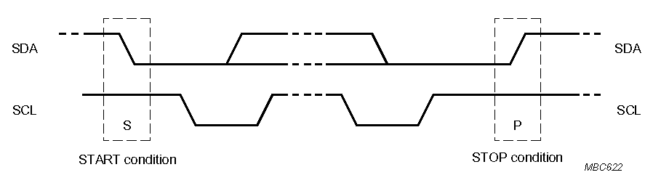
Start and Stop Conditions
A transition of the data line while the clock line is high (longer than a regular clock pulse width) is defined as either a start or a stop condition.
Both start and stop conditions are generated by the bus master
The bus is considered busy after a start condition, until a stop condition occurs
SDA
SDA
SCL
SCL
Start Condition
Stop Condition

Slide 130
I²C Addressing
Each node has a unique 7 (or 10) bit address
Peripherals often have fixed and programmable address portions
Addresses starting with 0000 or 1111 have special functions:-
0000000 Is a General Call Address
0000001 Is a Null (CBUS) Address
1111XXX Address Extension
1111111 Address Extension – Next Bytes are the Actual Address

Slide 131
First Byte in Data Transfer on the I²C Bus
MSB
LSB
R / Wr
7 – Bit Slave Address
ACK
R/Wr
0 – Slave written to by Master
1 – Slave read by Master
ACK – Generated by the slave whose address has been output.

Slide 132
Data transmission in I2C
If multiple devices are mounted on an I2C bus, doesn't the CPU send data and all peripherals can see it?
Yes, the CPU sends an address first, and all peripherals receive that address, which is like the name of the peripheral. The peripheral responses when its name is called; and doesn’t response until (acknowledge) it's called.

Slide 133
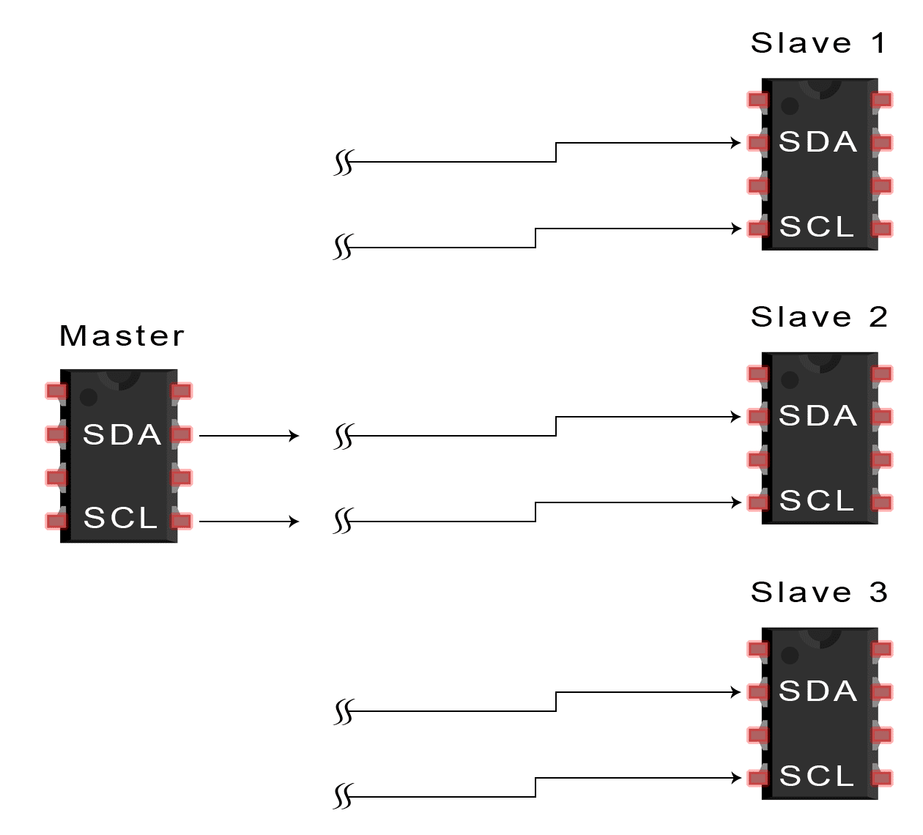
Data transmission in I2C
1. The master sends the start condition to every connected slave by switching the SDA line from a high voltage level to a low voltage level before switching the SCL line from high to low:

Slide 134
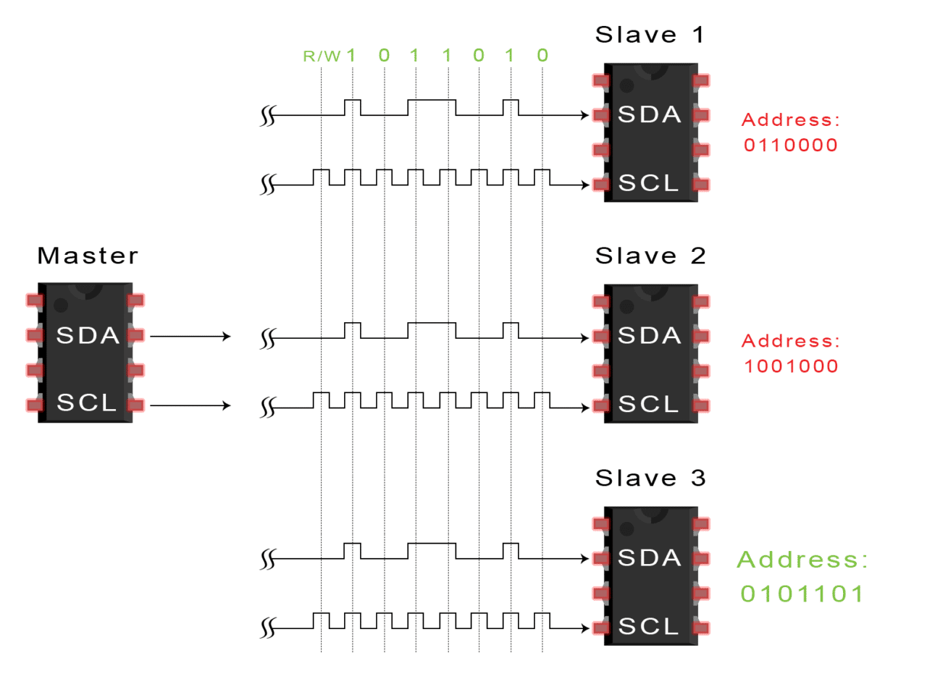
Data transmission in I2C
2. The master sends each slave the 7 or 10 bit address of the slave it wants to communicate with, along with the read/write bit:

Slide 135
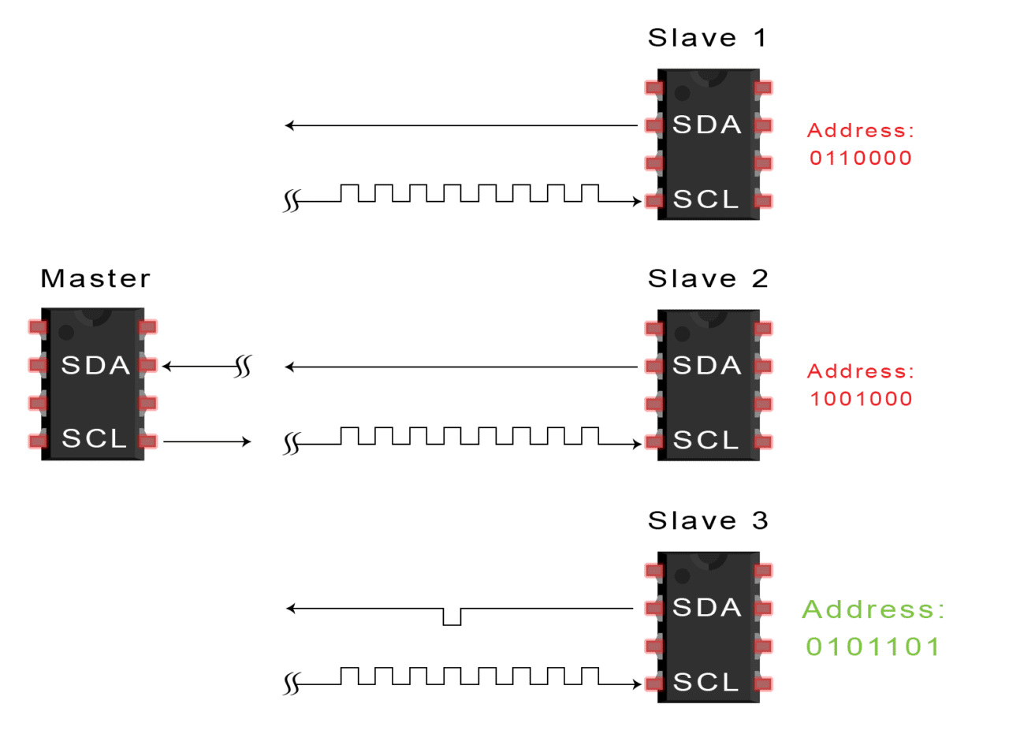
Data transmission in I2C
3. Each slave compares the address sent from the master to its own address. If the address matches, the slave returns an ACK bit by pulling the SDA line low for one bit. If the address from the master does not match the slave’s own address, the slave leaves the SDA line high.

Slide 136
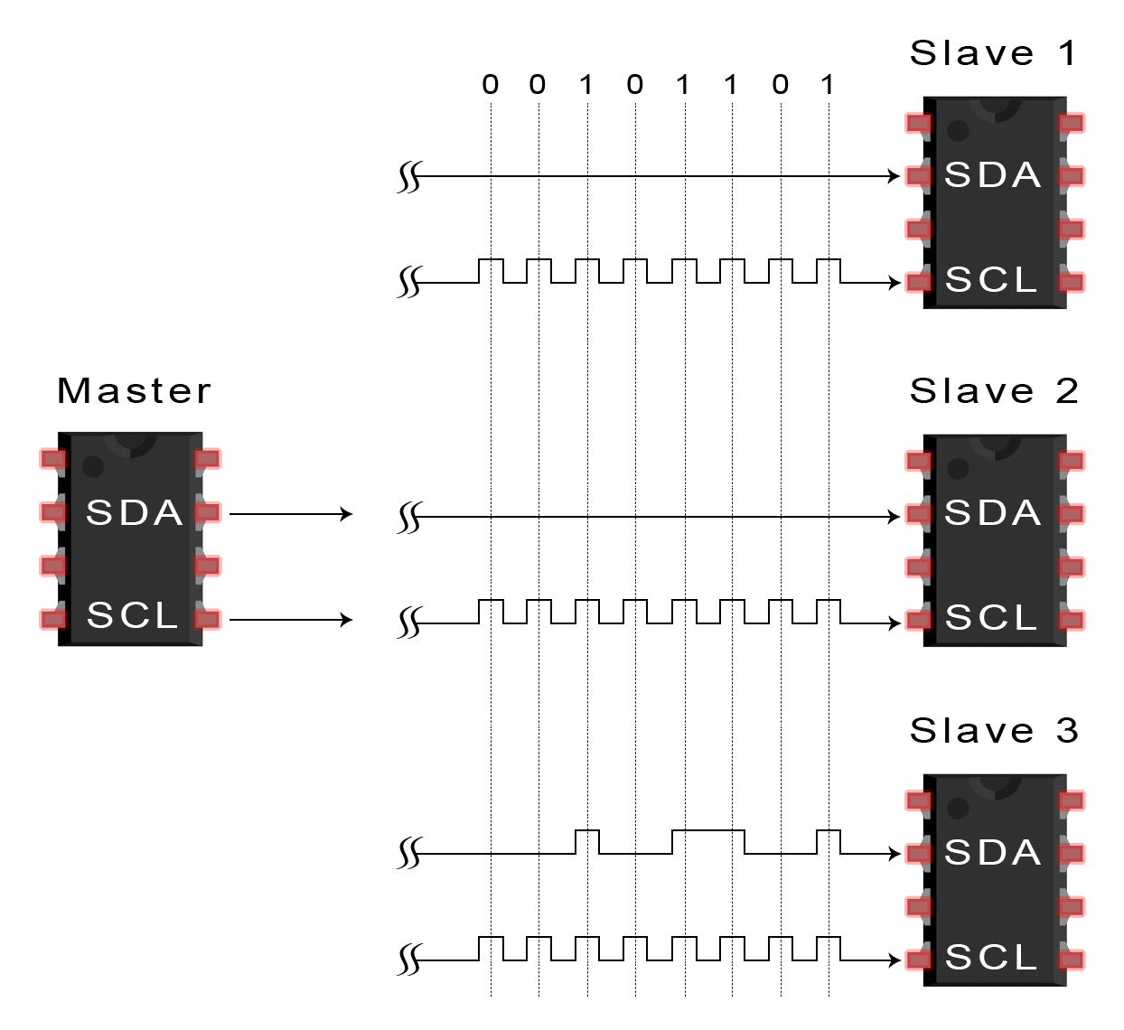
Data transmission in I2C
4. The master sends or receives the data frame.

Slide 137
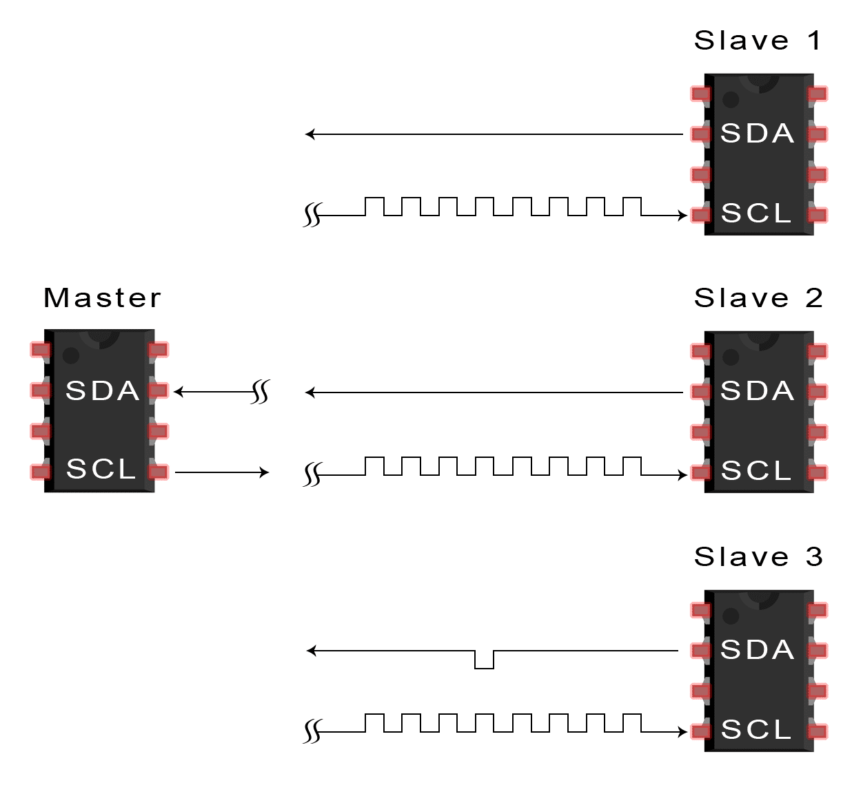
Data transmission in I2C
5. After each data frame has been transferred, the receiving device returns another ACK bit to the sender to acknowledge successful receipt of the frame.

Slide 138
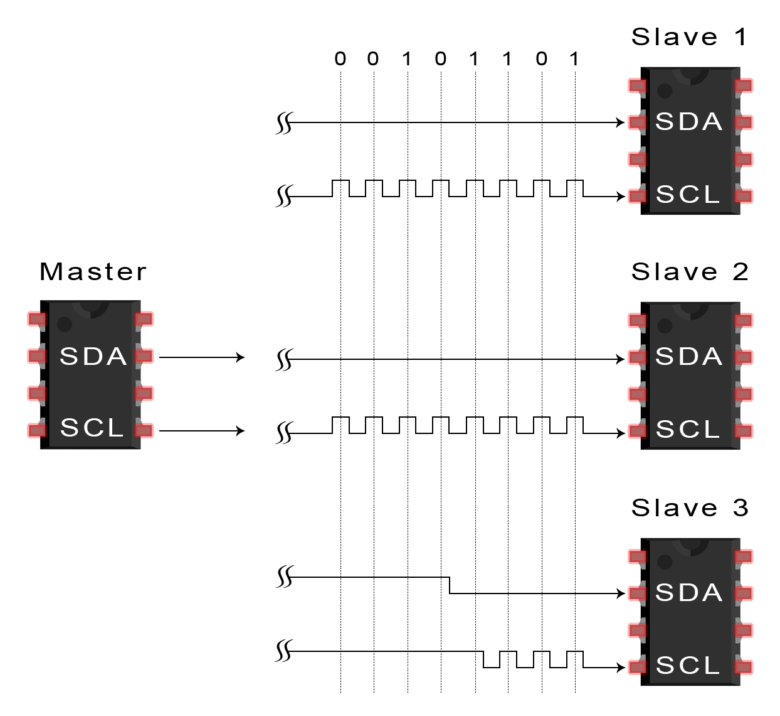
Data transmission in I2C
6. To stop the data transmission, the master sends a stop condition to the slave by switching SCL high before switching SDA high.

Slide 139
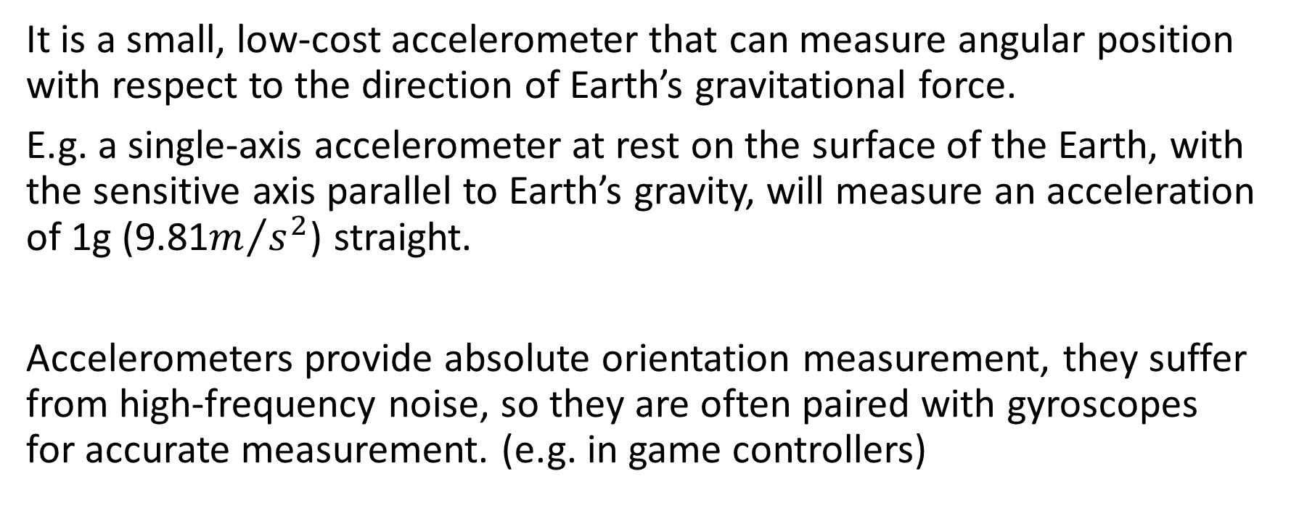
ADXL345 Accelerometer
It is a small, low-cost accelerometer that can measure angular position with respect to the direction of Earth’s gravitational force.
E.g. a single-axis accelerometer at rest on the surface of the Earth, with the sensitive axis parallel to Earth’s gravity, will measure an acceleration of 1g (9.81$m/{s^{2}}$) straight.
Accelerometers provide absolute orientation measurement, they suffer from high-frequency noise, so they are often paired with gyroscopes for accurate measurement. (e.g. in game controllers)

Slide 140
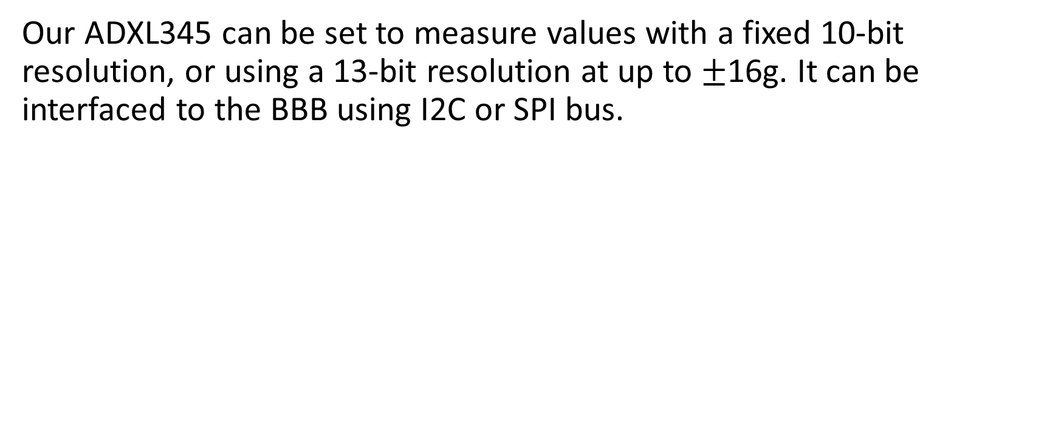
ADXL345 Accelerometer
Our ADXL345 can be set to measure values with a fixed 10-bit resolution, or using a 13-bit resolution at up to $±$16g. It can be interfaced to the BBB using I2C or SPI bus.

Slide 141
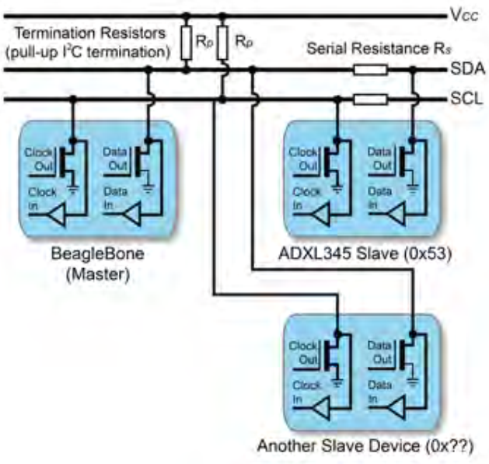
I2C Hardware in ADXL345 Accelerometer
I2C bus configuration

Slide 142
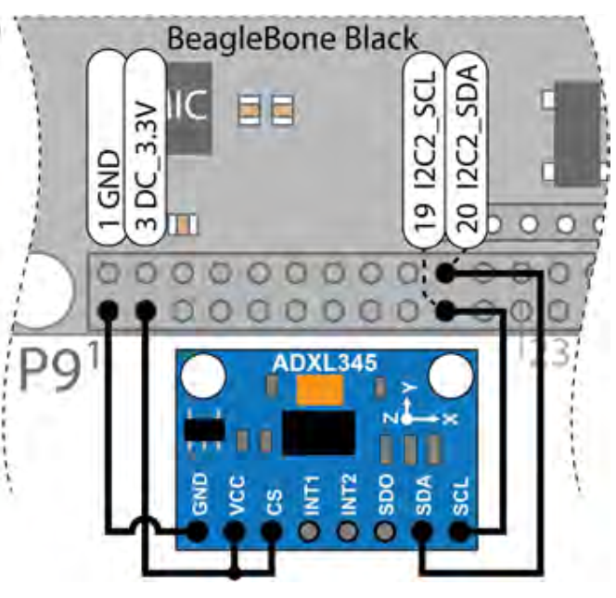
I2C Hardware in ADXL345 Accelerometer
When CS input is tied high, the ADXL345 is placed in I2C mode, the breakout board contains the resistors that are required for the I2C bus to work correctly. The ADXL345’s ALT address (Alternate) pin is fixed to GND on the breakout board, placing the device at I2C address 0X53.

Slide 143
INT is in ADXL345 Accelerometer
We know only master can initiate communication, and slave would never send data to master by its own initiative. But master can’t ask “do you have data for me” periodically since it will consume resources and may not go into sleep mode.
So slave has a way of telling the master, "I have the data." That's what the interrupt signal does. Slave has data, first send an interrupt signal to master, master then read the data sent by slave through I2C.

Slide 144
INT in ADXL345 Accelerometer
For low power application scenario, and slave trigger scenario, need to be designed in this way. For example, the capacitive touch screen can wake up the the CPU which is dormant.

Slide 145
Addressing in ADXL345 Accelerometer
In I2C, the slave address is determined by the salve device itself. E.g. ADXL345 breakout board has the address 0X53, which is determined at manufacture.
Many devices, including ADXL345, have selection inputs that allow you to alter this value within a defined range.

Slide 146
I2C Hardware
I2C buses on BBB
H/W Bus | S/W Device | SDA PIN | SCL PIN | Description
I2C0 | /dev/i2c-0 | N/A | N/A | Internal bus for HDMI control
I2C1 | /dev/i2c-2 | P9_18 | P9_17 | General I2C bus. Disable by default
I2C2 | /dev/i2c-1 | P9_20 | P9_19 | General I2C bus. Enable by default

Slide 147
I2C Hardware
Linux provide i2c-tools for interfacing to I2C bus devices. This tools is already installed on BBB, but we can update them.
The first step: i2cdetect to detect the device is present on the bus
If ADXL sensor is physically connected to the I2C bus (I2C2), the I2C2 bus can be probed (/dev/i2c-1)
$ i2cdetect –y –r 1

Slide 148
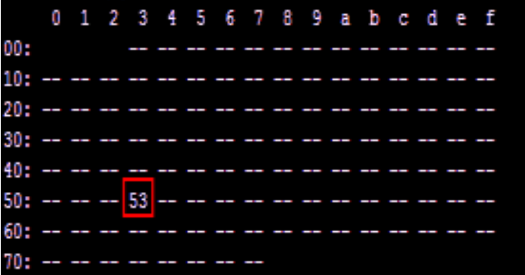
I2C Hardware
When -- is displayed, the address was probed but no device responded, when UU is displayed, probing was skipped, as the address is already in use by a driver. And if the device is functioning and correctly wired, it will appear at its predefined address, which is 0X53.
Running i2cdetect on the internal I2C0 will highlight there is a device at 0X34 which related to the consumer electronics control (CEC) interface on the HDMI.

Slide 149
I2C Hardware
We can enable i2c-2 (I2C1) as a second public I2C bus.
/dev$ sudo sh –c “echo BB-I2C1 > $SLOTS”
/dev$ ls i2*
i2c-0 i2c-1 i2c-2

Slide 150
I2C Hardware
i2cdump, this command can be used to read in the values of the registers and display them in a hexadecimal form consult the datasheet for slave device before using this command, since in certain modes i2cdump will write to the device.

Slide 151
I2C Hardware
i2cget, it can be used to read the value of a register in order to test the device, or as an input for Linux shell scripts.
E.g. to read the DEVIO of attached device
$ i2cget –y 1 0X53 0X00 0Xe5

Slide 152
I2C Hardware
i2cset, it can be used to set a register.
E.g. to take the ADXL345 out of power saving mode, by writing 0X08 to the power_CTL register, which at 0X2D
$ i2cset –y 1 0X53 0X2D 0X08
$ i2cget –y 1 0X53 0X2D 0X08

Slide 153
Interfacing Guide
Watch the video from the following link
https://www.youtube.com/watch?v=8C2zk6B-eLU

Slide 154
Session – February 8

Slide 155
ESE 3014 the SPI protocol and establishing communications between devices using SPI

Slide 156
SPI
The Serial Peripheral Interface (SPI) bus is a fast, full duplex synchronous serial data link that enables devices such as the BBB to communicate with other device over short distances.
Like I2C, the SPI bus is synchronous, but SPI is full duplex. This means that it can transmit and receive data at the same time, by separate lines for both sending data and receiving data (as we’ll see MOSI and MISO).

Slide 157
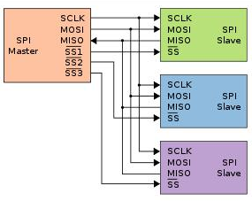
SPI
SPI has four wires, Serial clock (SCLK), Serial data output (SDO), Serial data input (SDI), and Slave select (SS).
SPI communication takes place between a single master device and one or more slave devices. The device who provide clock is the master device. Unlike I2C, SPI supports only one master, and it doesn’t have the acknowledge mechanism verifies that the data is received.

Slide 158
SPI
I2C has acknowledge mechanism.

Slide 159
SPI
The data output passes through the SDO line, where the data sends along the rising or falling edge, and reads along the next falling or rising edge, to complete one-bit data transfer. So, the transmission of 8-bit data requires at least 8 clock signal changes (the rising edge and the falling edge are counted as once).

Slide 160
SPI
While the normal serial communication transmits at least 8 bits of data continuously at one time, SPI allows data to be transmitted bit by bit, or even paused, because the SCLK is controlled by the master device, and when there is no clock jump, the slave device does not collect or transmit data. In other words, the master device can control the communication by controlling the SCLK.

Slide 161
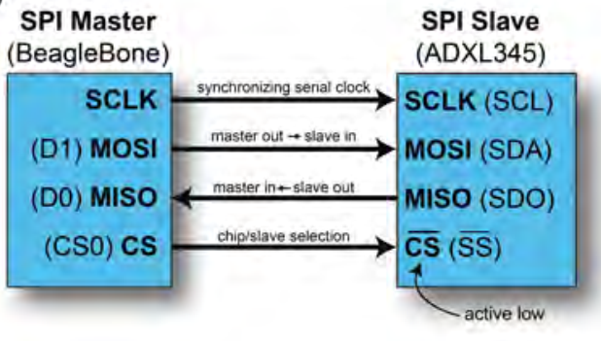
SPI
Four steps to communicate with SPI
1. The SPI master defines the clock frequency at which to synchronize the data communication channels.
2. The SPI master pulls the chip select (cs) line low, which activates the client device. It is therefore said to be active low. This line is also called as slave select (ss).

Slide 162
SPI
3. After a short delay, the SPI master issues clock cycles, sending data out on the master out – slave in (MOSI) line and receiving data on the master in – slave out (MISO) line. One bit is sent and one bit is received on each clock cycle. Usually is in one-byte (8 bit) chunks.
4. When complete, the SPI master stops sending a clock signal and then pulls the cs line high, deactivating the SPI slave device.

Slide 163
Data transmission in SPI
SPI needs to determine two things when it comes to data transfer:
First, whether the data is collected (reading) at the rising edge or the falling edge of the clock;
The second is whether the initial (idle) state of the clock is high or low.
Comparison: for I2C during the idle state and also when it is collecting data, the clock line is a high level, but SPI provides a more free way.

Slide 164
Data transmission in SPI
Two concepts
CPOL: clock polarity, means when SPI is in idle time, the clock signal is a high level or low level.
CPHA: clock phase, SPI equipment is sampling (reading) in the rising edge or falling edge of the clock.
So according to the standard, SPI data transmission there are four modes.

Slide 165
Data transmission in SPI
SPI data transmission there are four modes.
Mode | Clock Polarity (CPOL) | Clock Phase (CPHA)
0 | 0 (low at idle) | 0 (data captured on the rising edge of the clock signal)
1 | 0 (low at idle) | 1 (data captured on the falling edge of the clock signal)
2 | 1 (high at idle) | 0 (data captured on the falling edge of the clock signal)
3 | 1 (high at idle) | 1 (data captured on the rising edge of the clock signal)

Slide 166
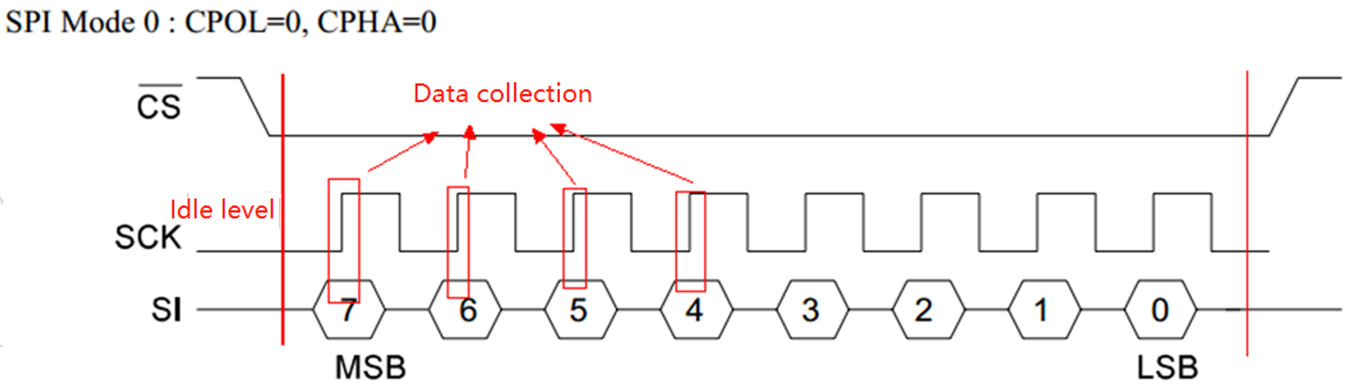
Data transmission in SPI
Mode 0

Slide 167

Data transmission in SPI
Mode 1

Slide 168

Data transmission in SPI
Mode 2

Slide 169

Data transmission in SPI
Mode 3

Slide 170

Data transmission in SPI
SPI in the hardware design adopts double cable system, according to the design, in the process of SPI communication, it can form a data link between master-slave equipment as a ring - the master to write a data to the slave, and the slave will be back to a data.

Slide 171
Data transmission in SPI
Assume that the master and slave are initialized and that the master's buff=0xAA=0b1010 1010 and the slave's buff=0x55=0b0101 0101. And we are in sending in rising edge, and reading in falling edge.
At the rising edge of clock (pulse) 1, master send out data as one bit from left side (MSB), plus the shifter, i.e., shift from right to left.
Clock
0
Master
1010 1010
Slave
0101 0101
SDI
X
SDO
X
Master
1 0101 010X
Just move (send) out
Don’t know yet since it didn’t read data from slave

Slide 172
Data transmission in SPI
At the same time, slave send out data from its left side (MSB), plus the shifter, i.e., shift from right to left.
Slave
0 1010 101X
Just move (send) out
Don’t know yet since it didn’t read data from master

Slide 173
Data transmission in SPI
At the falling edge of clock (pulse) 1, it is time to read data.
Master
0101 010X
Master
0101 0100
Send from slave
Slave
1010 101X
Slave
1010 1011
Send from master

Slide 174
Data transmission in SPI
Summary:
1. A clock cycle completes the sending and receiving of data.
2. Both the master and the slave send first from the MSB (left side), and the data received is added to the right side.
3. Eight clock cycles complete a data exchange for one byte.

Slide 175
SPI
Do not connect a 5V SPI slave device to your BBB, if so, use logic-level translation.
Both SPI0 and SPI1 bus are accessible from P9, SPI1 clashes with the mcasp0_pins, so to use SPI1, you should disable HDMI to remove device tree, and enable SPI0 and SPI1 since they are disabled by default (Ref: Exploring Beagle bone, Derek Molloy).

Slide 176

SPI
The pin for SPI1 are shown:
Chip Select: P9_28 spi1_cs0 (Mode 3) $PINS 103 Offset 0x19C.
MOSI: P9_30 spi1_d1 (Mode 3) $PINS 102 Offset 0x198.
MISO: P9_29 spi1_d0 (Mode 3) $PINS 101 Offset 0x194.
Clock: P9_31 spi1_sclk (Mode 3) $PINS 100 Offset 0x190.

Slide 177
Advantages of SPI
• Full duplex
• Push-pull drivers
• Higher throughput than I²C or SMBus.
• Not limited to any maximum clock speed, enabling potentially high
speed
• Not limited to 8-bit words
• Slaves use the master's clock and do not need precision oscillators
• Slaves do not need a unique address — unlike I²C or GPIB or SCSI

Slide 178
Limitations of SPI
• Requires more pins on IC packages than I²C
• No hardware flow control by the slave (but the master can delay the
next clock edge to slow the transfer rate)
• No hardware slave acknowledgment (the master could be
transmitting to nowhere and not know it)
• Typically supports only one master device (depends on device’s
hardware implementation)
• No error-checking protocol is defined

Slide 179
Session – February 22

Slide 180
Elucidate the UART protocols and establish communications between devices in conjunction with RS-232

Slide 181
UART
UART(Universal Asynchronous Receiver/Transmitter), it is a microprocessor peripheral device used for the serial transfer of data , one bit at a time, between two electronic devices. UARTs were originally standalone ICs, but now are often integrated with the host microprocessor/microcontroller.

Slide 182
UART
A UART is not, a strictly speaking bus, but its capacity to implement serial data communications overlaps with similar capacities with I2C and SPI. It is described as asynchronous because the sender does not have to send a clock signal to synchronize the transmission, rather a communication structure is agreed upon that uses start and stop bit to synchronize the transmission of data.

Slide 183
Variations and fun times
UART is actually a generic term that includes a large number of different devices/standards.
RS-232 is a standard that specifies
“electrical characteristics and timing of signals, the meaning of signals, and the physical size and pin out of connectors.

Slide 184
UART
No clock = only two signal lines.
Just like a regular telephone line, the transmit data connection (TXD) from one end is connected to the receive data connection (RXD) on the other end of connection.

Slide 185
UART
Normally, UARTs have been used with level converters/ line drivers to implement such as RS-232 or RS-485, but for short-distance communications, it is possible to use the original logic level for the UART outputs and inputs to enable two UART to communicate with each other.

Slide 186

Protocol
Each character is sent as
a logic low start bit
a configurable number of data bits (usually 7 or 8, sometimes 5)
an optional parity bit
one or more logic high stop bits
with a particular bit timing (“baud”)
Examples
“9600-N-8-1” → <baudrate><parity><databits><stopbits>
“9600-8-N-1” → <baudrate><databits><parity><stopbits>

Slide 187

UART
In UART, transmission begins when the transmitter sends a start bit (logic low) on the receiver’s end, the falling edge of the start bit is detected and then after 1.5 bit periods, the first bit value is sampled. Every subsequent bit is sampled after 1.0 bit period, until the agreed upon number of bits is transferred. (normally seven or eight).

Slide 188
UART
The parity bit is optional, if used, it can identify whether a transmission error has occurred. Finally, one stop bit is sent, which is always a logic high. This is a standard 8N1 form, means that 8 bits are sent in each frame.

Slide 189
UART
Baud rate: Data transfer rate. There are the following: 300, 600, 1200, 2400, 4800, 9600, 19200, 38400, 43000, 56000, 57600, 115200. On both sides of data transmission and reception, the baud rate needs to be unified in advance in order to transmit data correctly.

Slide 190
UART
BBB UART Header Pins
We use UART4 of BBB. We can test UART4 by loopback (wiring) P9_11 to P9_13 “talking to itself”. Once the wiring is complete, the UART4 overlap is loaded in order to enable UART.
 | UART1 | UART2 | UART3 | UART4 | UART5
TXD | P9_24 (0) | P9_21 (1) | Not exposed | P9_13 (6) | P8_37 (4)
RXD | P9_26 (0) | P9_22 (1) | Not exposed | P9_11 (6) | P8_38 (4)

Slide 191

UART
P9_13 UART4_TXD: Output that transmits data to a receiver
P9_11 UART4_RXD: Input that receives data from a transmitter

Slide 192
UART
When the overlay is loaded, the contents of the /dev directory now includes a new entry for ttyO4 (letter O, not zero).
The first human computer interface was the teletypewriter, also known as the teletype or TTY, an electromechanical typewriter that can be used to send and receive messages. It is still in use today.
This “teletype” (terminal) device, which is a software interface that enables you to send and receive data. On the UART we can check the available terminal devices:
/dev$ ls ttyO*
ttyO0 ttyO4

Slide 193
UART
By using minicom:
∼$ minicom ‐b 9200 ‐o ‐D /dev/ttyO4
Port /dev/ttyO4
Press CTRL-A Z for help on special keys
Type Ctrl+A followed by Z and then E to turn on local Echo. Now, whichever key you press is transmitted from the TXD output, and is also echoed on the console. When the character is received on the RXD input, it is then displayed on console. So if you can see the characters you typed appearing twice, that means UART working correctly.

Slide 194
Arduino UART
Arduino is a popular, lowcost, and powerful microcontroller that can be a very useful companion controller for the BBB.
You can find some videos on exploringbeaglebone website on getting started with Arduino
I post the link of GitHub for the programming environment (BBBSerialEcho.ino) for Arduino on your moodle.

Slide 195

Arduino UART
The setup() function is called once when the program is started. It configures the serial port to use a baud rate with a 8N1 format.
The loop() function will repeat as fast as it possible.
Serial Monitor Window can be opened in the Arduino development environment by pressing the button in the top right-hand corner.

Slide 196


Arduino UART
Choose the baud rate that corresponds in the program. When a string is entered in the text field and the send button is pressed, the string is sent to the Arduino and the response should display in the text area.

Slide 197

Arduino UART
BBB 3.3V supply, TXD, and RXD are connected to lv, 1, 2. And on the other side of converter, Arduino 5V supply, RXD, TXD is connected to hv, 1, 2.

Slide 198
Rs-232 Standard
In RS-232, user data is sent as a time series of bits.
Both synchronous and asynchronous transmissions are supported by the standard.
RS-232 devices may be classified as Data Terminal Equipment (DTE) or Data Communication as modems, that are responsible for data transferring Equipment (DCE),
this defines that each device which wires will be sending and receiving each signal.
DTE refers to terminals and computers that sends and receives data.
DCE refers to communication equipment, such

Slide 199

DIFFERENT TYPES OF RS-232 CABLES

Slide 200

RS-232 pins

Slide 201
Advantage of RS232
RS232 interface is supported in many compatible legacy devices due to its simplicity.
It supports long distances of about 50 feet (for low baud rates) and with error correction capabilities.
RS232 is free from noise due to use of +/-5 Volts or higher for binary logic 0 and logic 1.
RS232 is low cost interface.
Converters or adaptors are available at cheaper rates for conversion from RS232 to RS485/USB/Ethernet etc

Slide 202
Disadvantages of RS232
Suitable for system to system communications. not suitable for chip to chip or chip to sensor device communications.
Supports lower speed for long distances. Higher speed (i.e. 115200 baud) can be achieved for short distances only.
RS232 interface requires separate transceiver chips which will add cost to the system.
It is used for single master and single slave configuration and not for single master-multiple slaves mode.
It is unbalanced transmission.

Slide 203
UART v.s. RS-232
UART is responsible for sending and receiving a sequence of bits. At the output of a UART these bits are usually represented by logic level voltages. These bits can become RS-232, RS-422, RS-485, or perhaps some proprietary spec.
RS-232 specifies voltage levels. Notice that some of these voltage levels are negative, and they can also reach ±15V. Larger voltage swing makes RS-232 more resistant to interference (albeit only to some extent).
A microcontroller UART can not generate such voltages levels by itself. This is done with help of an additional component: RS-232 line driver. A classic example of an RS-232 line driver is MAX232. If you go through the datasheet, you'll notice that this IC has a charge pump, which generates ±10V from +5V.

Slide 204
UART v.s. RS-232
As we mentioned UARTs do not typically interface directly with RS-232. You will need to convert the output of the UART to the +/-12V standard that RS-232 requires. A complete RS-232 interface will typically involve both a UART and an RS-232 level converter. Further, the RS-232 standard includes the definition of several other signalling pins besides TX and RX, which you may need to use depending on the equipment you need to connect to. These will also need to be level converted, and your UART may, or may not, support these signals. If it does not you will have to control them with your software/firmware directly.
So while a UART may help you implement an RS-232 interface, it is not an RS-232 interface itself.
﻿Final word: The UART functions to convert parallel data from PC bus lines to serial data for transmission via line drivers to RS-232, RS-422, and RS-485 devices.

Slide 205

RS-232 transmission example

Slide 206
Session – March 1

Slide 207
Have you already prepared the Components?

Slide 208
the IrDA infrared protocol and communications between devices using IrDa infrared.

Slide 209
IrDA
As engineers design more and more products with embedded computer systems that require connections of one sort or another, we've got to pay attention to the ease with which these connections can be made. Short-range wireless protocols offer an attractive alternative to wired connections.
Of course, numerous types of localized wireless communications are possible. But as far as I can tell, only three wireless "media" are in common use today: infrared light, radio frequency radiation, and soundwaves. Examples of products that use each of these media are TV remote controls, cell phones, and "The Clapper," respectively.

Slide 210

IrDA
To date, infrared has been the hands-down winner in the move toward localized wireless communications. One standard, called IrDA-Data, has already found a place in some 50 million laptops, printers, handheld PCs, and other devices. It helps, of course, that infrared transmissions are inherently localized and that governments do not regulate the infrared portion of the light spectrum. It helps, too, that the components of an infrared transceiver have been perfected and their costs reduced through their successful use in so many remote control applications. But what if you want to send generic data-rather than one of a small number of commands-or communicate bidirectionally? That's where IrDA-Data comes in.

Slide 211
IrDA
The Infrared Data Association (IrDA) is an industry-driven interest group that was founded in 1993 by around 50 companies. IrDA provides specifications for a complete set of protocols for wireless infrared communications, and the name "IrDA" also refers to that set of protocols. The main reason for using the IrDA protocols had been wireless data transfer over the "last one meter" using point-and-shoot principles. Thus, it has been implemented in portable devices such as mobile telephones, laptops, cameras, printers, and medical devices. Main characteristics of this kind of wireless optical communication is physically secure data transfer, line-of-sight (LOS) and very low bit error rate (BER) that makes it very efficient.

Slide 212
IrDA
This first IrDA standard paved the way for asynchronous data communications at rates up to 115.2Kbps and synchronous communications at 1.152Mbps. (A synchronous 4Mbps option was added to the standard about a year and a half later.) This standard is now formally known as IrDA-Data, to distinguish it from other standards bearing the IrDA moniker, including IrDA-Control. The latter is a specification for communication between cordless input devices (keyboards, mice, and so on) and the computers they control. Although IrDA-Control is perhaps another interesting avenue for later discussion, I'll avoid it and talk only about IrDA-Data in this course.

Slide 213

IrDA
The following Figure shows a typical application of the IrDA-Data protocol. In this example, the infrared transmitter in a nomadic embedded system is aimed in the direction of a nearby printer and a document is transferred to it. If all goes well, a hard copy of the document will result-without connecting any wires or configuring either device. I've actually done this in my home office, with a laptop, handheld PC, and laser printer from three different manufacturers. It's a beautiful system to use, but how does it work? And how much does it "cost" to implement?

Slide 214
Layers in IrDA
Like any communications standard, IrDA-Data works on the layering principle. A series of hardware and software components are layered one on top of the other (the hardware is always at the bottom) to form a protocol stack. Equivalent layers exist on each device and the two application programs that want to communicate do so by making calls into their local stack.

Slide 215
Layers in IrDA
The IrDA-Data protocol stack contains the usual suspects: a physical layer that defines data rates, the encoding of individual bits, and the way that bits are combined into frames; a data link layer that provides addressing, error detection, and retransmission capabilities to ensure the reliable delivery of all packets; and a link management layer that enables multiple simultaneous conversations between the two connected systems. These layers are roughly equivalent in function to the Ethernet, IP, and TCP layers of a typical TCP/IP implementation. (Though that is not to suggest that IrDA-Data and TCP/IP are directly compatible.)

Slide 216

The OSI reference Model in IrDA
The OSI model consists of seven distinct layers stacked on one another: Physical, Data Link, Network, Transport, Session, Presentation, and Application. Each layer handles specific communication tasks and uses specific types of protocol to communicate with the next layer in the stack.

Slide 217
The OSI reference Model
Communications between two network devices go up and down the layered stack at each device. For example, when a workstation communicates with a server, communication starts at the workstation Application layer. It then formats specific information through the lower layers until the data reaches the Physical layer and it transmitted over the network to the server.

Slide 218
The OSI reference Model
The server picks up the data at the Physical layer of its stack and sends it up each layer for interpretation until it reaches the Application layer. Each layer is called by its actual name or by its placement in the stack. For example, the bottom layer is called either the Physical layer or Layer 1.

Slide 219
The OSI reference Model
The bottom layers perform functions, such as constructing frames and transmitting packet containing signals, related to physical communications, The middle layers coordinate network communications between nodes, ensuring that a communication session continues without interruptions or errors.

Slide 220
The OSI reference Model
For example, the top layers perform work that directly affects software applications and data presentation, including data formatting, encryption, and data and file transfer management. Taken together, the set of layers is called a stack.

Slide 221
IrPHY
The mandatory IrPHY (Infrared Physical Layer Specification) is the physical layer of the IrDA specifications. It comprises optical link definitions, modulation, coding, cyclic redundancy check (CRC) and the framer.
Notes:
A cyclic redundancy check (CRC) is an error-detecting code commonly used in digital networks and storage devices to detect accidental changes to raw data. Blocks of data entering these systems get a short check value attached, based on the remainder of a polynomial division of their contents. On retrieval, the calculation is repeated and, in the event the check values do not match, corrective action can be taken against data corruption. It can be used for error correction.

Slide 222
IrPHY
Different data rates use different modulation/coding schemes:
SIR: 9.6–115.2 kbit/s, asynchronous, RZI, UART-like, 3/16 pulse
MIR: 0.576–1.152 Mbit/s, RZI, 1/4 pulse, HDLC bit stuffing
FIR: 4 Mbit/s, 4PPM
VFIR: 16 Mbit/s, NRZ, HHH(1,13)
UFIR: 96 Mbit/s, NRZI, 8b/10b
GigaIR: 512 Mbit/s – 1 Gbit/s, NRZI, 2-ASK, 4-ASK, 8b/10b

Slide 223
IrPHY
Range:
standard: 2 m;
low-power to low-power: 0.2 m;
standard to low-power: 0.3 m.
The 10 GigaIR also define new usage models that supports higher link distances up to several meters.

Slide 224

IrPHY
Angle: minimum cone ±15°
Speed: 2.4 kbit/s to 1 Gbit/s
Modulation: baseband, no carrier
Wavelength: 850–900 nm
Infrared window (part of the device body transparent to infrared light beam)
IR window :
https://www.youtube.com/watch?v=GIgY4ZSLhUA

Slide 225

IrPHY
The frame size depends on the data rate mostly and varies between 64 B and 64 kB. Additionally, bigger blocks of data can be transferred by sending multiple frames consecutively. This can be adjusted with a parameter called "window size" (1–127). Finally, data blocks up to 8 MB can be sent at once. Combined with a low bit error rate of generally <${10}^{−9}$, that communication could be very efficient compared to other wireless solutions.

Slide 226
IrPHY
IrDA transceivers communicate with infrared pulses (samples) in a cone that extends at least 15 degrees half angle off center. The IrDA physical specifications require the lower and upper limits of irradiance such that a signal is visible up to one meter away, but a receiver is not overwhelmed with brightness when a device comes close. In practice, there are some devices on the market that do not reach one meter, while other devices may reach up to several meters. There are also devices that do not tolerate extreme closeness.

Slide 227
IrPHY
The typical sweet spot for IrDA communications is from 5 to 60 cm away from a transceiver, in the center of the cone. IrDA data communications operate in half-duplex mode because while transmitting, a device’s receiver is blinded by the light of its own transmitter, and thus full-duplex communication is not feasible. The two devices that communicate simulate full-duplex communication by quickly turning the link around. The primary device controls the timing of the link, but both sides are bound to certain hard constraints and are encouraged to turn the link around as fast as possible.

Slide 228
IrLAP
The mandatory IrLAP (Infrared Link Access Protocol) is the second layer of the IrDA specifications. It lies on top of the IrPHY layer and below the IrLMP layer. It represents the data link layer of the OSI model.
The most important specifications are:
Access control
Discovery of potential communication partners
Establishing of a reliable bidirectional connection
Distribution of the primary/secondary device roles
Negotiation of QoS parameters
Notes:
On the IrLAP layer the communicating devices are divided into a "primary device" and one or more "secondary devices". The primary device controls the secondary devices. Only if the primary device requests a secondary device to send, it is allowed to do so.

Slide 229
IrLMP
The mandatory IrLMP (Infrared Link Management Protocol) is the third layer of the IrDA specifications. It can be broken down into two parts. First, the LM-MUX (Link Management Multiplexer), which lies on top of the IrLAP layer. Its most important achievements are:
Provides multiple logical channels
Allows change of primary/secondary devices
Second, the LM-IAS (Link Management Information Access Service), which provides a list, where service providers can register their services so other devices can access these services by querying the LM-IAS.

Slide 230
Tiny TP
Tiny TP
The optional Tiny TP (Tiny Transport Protocol) lies on top of the IrLMP layer. It provides:
Transportation of large messages by SAR (Segmentation and Reassembly)
Flow control by giving credits to every logical channel

Slide 231
OBEX
OBEX
The optional OBEX (Object Exchange) provides the exchange of arbitrary data objects (e.g., vCard, vCalendar or even applications) between infrared devices. It lies on top of the Tiny TP protocol, so Tiny TP is mandatory for OBEX to work.
Notes:
vCard, also known as VCF, is a file format standard for electronic business cards. vCards are often attached to e-mail messages but can be exchanged in other ways, such as Multimedia Messaging Service, on the World Wide Web, instant messaging or through QR code.

Slide 232
IrDA’s Services
Above the link management layer the software is more varied. Each type of IrDA-compatible system provides its own unique set of services. For example, a printer may offer only a printing service, whereas a cellular phone may offer voice services, Internet-connection services, and address book services. Each of these services may require additional protocol layers above the link management layer. And, of course, every device needs a way to advertise the services it offers so that other systems may take advantage of them.

Slide 233
IrDA’s Services
In order to advertise their services, each IrDA-compatible device must incorporate a "yellow pages" protocol called the Information Access Protocol. When two devices approach each other and are ready to do business, they use this service to exchange information about their capabilities. The client in the transaction asks the server if it offers the desired service. For example, if you aim your PDA (Personal Digital Assistants, PDAs are small networked computers which can fit in the palm of your hand) at another IrDA-compatible system and say "print this note," the PDA will query the remote device's yellow pages to find out if a printing service is available there.

Slide 234
IrDA’s Services
If so, the document will be transmitted to the printing service at the indicated service address (analogous to a TCP port). If not, you'll get an error message on your PDA indicating that that type of service is not available.
This brings up an important point about infrared communications: you never have to wonder which device you are actually talking to. The infrared signal is emitted in a narrow cone of light and with very little signal strength. You've generally got to be within one meter of the other device and have your infrared transceiver pointed in its approximate direction. So there's not much fear of interference from other IrDA devices (except from fluorescent lights and other background producers of infrared radiation) or eavesdropping.

Slide 235
Optocoupler
Optocoupler is an electronic IrDA-compatible component that transfers electrical signals between two isolated circuits by using light. Optocouplers prevent high voltages from affecting the system receiving the signal.
A common type of optocoupler consists of an LED and a phototransistor in the same opaque package. Usually optocoupler transfer digital (on-off) signals, but some techniques allow them to be used with analog signals.
Notes:
Also called optocoupler

Slide 236

Optocoupler
Schematic diagram of an optocoupler showing source of light (LED) on the left, dielectric barrier in the center, and sensor (phototransistor) on the right

Slide 237
Optocoupler
An optocoupler contains a source (emitter) of light, almost always a near infrared light-emitting diode (LED), that converts electrical input signal into light, a closed optical channel, and a photosensor, which detects incoming light and either generates electric energy directly, or modulates electric current flowing from an external power supply.

Slide 238
HCPL-2200/2219 Optocouplers
The HCPL-2200/2219 are optically coupled logic gates that combine a GaAsP LED and an integrated high gain photo detector.
The detector has a three-state output stage and has a detector threshold with hysteresis.
The three-state output eliminates the need for a pullup resistor and allows for direct drive of data busses.
The HCPL-2200/2219 are useful for isolating high speed logic interfaces, buffering of input and output lines, and implementing isolated line receivers in high noise environments

Slide 239

HCPL-2200/2219 Optocouplers
Functional Diagram

Slide 240
HCPL-2200/2219 Optocouplers
Applications
• Isolation of high speed logic systems
• Computer-peripheral interfaces
• Microprocessor system interfaces
• Ground loop elimination
• Pulse transformer replacement
• Isolated buss driver
• High speed line receiver

Slide 241
Summary
The IrDA-Data protocol reflects the good and bad features of the environments in which it is typically used. For example, because no opportunity for eavesdropping exists, built-in encryption isn't available; because you can see the device at which you're aiming, you don't need to select the device with which you want to communicate from a pull-down list; device and service addresses are short; collisions between multiple senders are rare; but temporary interruptions of the signal (you set your coffee cup down between the devices, for example) are commonplace. IrDA-Data is designed to thrive in this type of environment. And it does.

Slide 242
Summary
Current applications of IrDA-Data include printing documents, connecting to a network, exchanging business cards, and synchronizing the address books on two distinct devices (a PDA and a cell phone, for example). What all of these applications have in common is that the user is actively engaged. It's the user who points one device at another and begins the transfer of information.

Slide 243
Session – March 8

Slide 244
How JTAG works and its purpose in the context of embedded systems

Slide 245
Attention
No lab for this module!

Slide 246
Introduction
A bed of nails tester is a traditional electronic test fixture which has numerous pins inserted into holes in an epoxy phenolic glass cloth laminated sheet (G-10) which are aligned using tooling pins to make contact with test points on a printed circuit board and are also connected to a measuring unit by wires. Named by analogy with a real-world bed of nails, these devices contain an array of small, spring-loaded pogo pins; each pogo pin makes contact with one node in the circuitry of the DUT (device under test). By pressing the DUT down against the bed of nails, reliable contact can be quickly and simultaneously made with hundreds or even thousands of individual test points within the circuitry of the DUT.

Slide 247
Introduction
The hold-down force may be provided manually or by means of a vacuum or a mechanical presser, thus pulling the DUT downwards onto the nails.
Devices that have been tested on a bed of nails tester may show evidence of this after the process: small dimples (from the sharp tips of the Pogo pins) can often be seen on many of the soldered connections of the PCB..

Slide 248

Introduction
INCREASED PROBLEM OF TEST

Slide 249

Introduction
Circuit Complexity

Slide 250

Introduction
DEVELOPMENT COST

Slide 251
Introduction
JTAG (1149.1 STANDARD) as a Solution
IEEE 1149.1, a standard 4 wire serial protocol that established the details of access to any chip with a JTAG port .
Boundary scan testing of Integrated
Circuits(IC’s) and boards
Debug Embedded devices
System level debug capability

Slide 252
JTAG
JATG (Joint Test Action Group) is an industry standard for verifying designs and testing printed circuit boards after manufacture.
JTAG was originally used to Test the chips. The basic principle of JTAG is to define a TAP (Test Access Port) inside the device to Test the internal nodes through the special JTAG Test tool. JTAG testing allows multiple devices to be connected in series through the JTAG interface to form a JTAG chain, which enables separate testing of each device. Today, JTAG interface is often used to implement ISP (in-system Programmer), programming FLASH and other devices.

Slide 253
JTAG
What can it be used for?
The standard defines instructions that can be used to perform :
n
Functional Tests Interconnect tests
n
n
Built-in self test procedures.

Slide 254
JTAG
n What is Boundary Scan?
Boundary scan is a methodology allowing complete
controllability and observability of the boundary pins of a JTAG
compatible device via software control.

Slide 255

JTAG
Boundary Scan Architecture

Slide 256
JTAG
BOUNDARY SCAN PRINCIPLE
n
How does it work?
The top level schematic of the test logic defined by IEEE Std 1149.1 includes three key blocks:
The TAP Controller
This responds to the control sequences supplied through the test access port (TAP) and generates the clock and control signals required for correct
operation of the other circuit blocks.
The Instruction Register
This shift register-based circuit is serially loaded with the instruction that selects an operation to be performed.
The Data Registers
These are a bank of shift register based circuits. The stimuli required by an operation are serially loaded into the data registers selected by the current instruction. Following execution of the operation, results can be shifted out for examination.

Slide 257
JTAG
JTAG Test Access Port
n The JTAG Test Access Port (TAP) contains four pins that drive the circuit blocks and control the operations specified. The TAP facilitates the serial loading and unloading of instructions and data.
The four pins of the TAP are:
TMS - Test Mode Select TCK - Test Clock
n
n
TDI - Test Data Input TDO - Test Data Output
n
n

Slide 258
JTAG
JTAG Test Access Port (Contd)
The function of each TAP pin is as follows:
n TCK - this pin is the JTAG test clock. It sequences the TAP controller as well as all of the JTAG registers
n TMS - this pin is the mode input signal to the TAP Controller. The state of TMS at the rising edge of TCK determines the sequence of states for the TAP controller.

Slide 259
JTAG
JTAG Test Access Port
TDI - this pin is the serial data input to all JTAG
instruction and data registers. TDI is sampled into the
JTAG registers on the rising edge of TCK.
TDO - this pin is the serial data output for all JTAG instruction and
data registers.. TDO changes state on the falling edge of TCK and
is only active during the shifting of data through the device. This pin
is three-stated at all other times

Slide 260
JTAG
JTAG TAP Controller
The JTAG TAP Controller is a
1.
16-state finite state machine, that controls the scanning of data into the various registers of the JTAG architecture. The state of the TMS pin at the rising edge of TCK is
2.
responsible for determining the sequence of state transitions. There are two state transition paths for scanning the signal at TDI in to the device,
3.
one for shifting in an instruction to the instruction register ,and , one for shifting data into the active data register as determined by the current instruction.
¡
¡

Slide 261

JTAG
JTAG TAP Controller logic

Slide 262
JTAG
Data Registers
n The Device ID register (IDR) reads-out an
identification number which is hardwired into the chip.
n The Bypass register (BR) is a 1-cell pass-through register which connects the TDI to the TDO with a 1-clock delay to give test equipment easy access to another device in the test chain on the same board.
n The Boundary Scan register (BSR), intercepts all the signals between the core-logic and the pins.

Slide 263
JTAG
Test Process
The standard test process for verifying a device or circuit board using boundary-scan technology is as follows:
n The tester applies test or diagnostic data on the input pins of the device.
n The boundary-scan cells capture the data in the
boundary scan registers monitoring the input pins. n Data is scanned out of the device via the TDO pin, for verification.
n Data can then be scanned into the device via the TDI pin.
n The tester can then verify data on the output pins of the device.

Slide 264

JTAG
REAL JTAG APPLICATIONS

Slide 265
Summary
Advantages of JTAG
The need for physical test points on the board is eliminated
leading to significant savings as a result of simpler board
layouts.
n
n
Less costly test fixtures
n
reduced time on in-circuit test systems increased use of standard interfaces faster time-to-market
n
n

Slide 266
Session – March 15

Slide 267
The USB protocol and communications between devices using USB.

Slide 268
Introduction
USB is an interface that connects a device to a computer.
With this connection, the computer sends or retrieves data from the device.
USB gives developers a standard interface to use in many different types of applications.
A USB device is easy to connect and use because of a systematic design process.

Slide 269
Physical Interface
From a high-level overview, the physical interface of USB has two components: cables and connectors. These connectors connect devices to a host.
A USB cable consists of multiple components that are protected by an insulating jacket. Underneath the jacket is an outer shield that contains a copper braid. Inside the outer shield are multiple wires: a copper drain wire, a VBUS wire (red), and a ground wire (black).

Slide 270

Physical Interface
An inner shield made of aluminum contains a twisted pair of data wires as seen in the following Figure.

Slide 271
Physical Interface
There is a D+ wire (green) and a D- wire (white). In Full-Speed and High-Speed devices, the maximum cable length is 5 meters. To increase the distance between the host and a device, you must use a series of hubs and 5-meter cables.
While USB extension cables exist in the market, using them to exceed 5 meters is against the USB specification. Low-Speed devices have slightly different specifications.

Slide 272

Physical Interface
Their cable length is limited to 3 meters and Low-Speed cables are not required to be a twisted pair as the following Figure shows.
USB communication occurs through many different signaling states on the D+ and D- lines. Some of these states transmit the data while others are used as specific signaling conditions.
Differential 0 and Differential 1: These two states are used for general data communication across USB. Differential 1 is when the D+ line is high and the D- line is low. Differential 0 is when the D+ line is low and the D- line is high.

Slide 273
Physical Interface
J-State and K-State: In addition to the differential signals, the USB specification defines two additional differential states: J-State and K-State. Their definitions depend on the device speed. On a Full-Speed and High-Speed device, a J-State is a Differential 1 and a K-State is a Differential 0. The opposite is true for a Low-Speed device.
Single Ended Zero (SE0): Condition that occurs when both D+ and D- are driven low. This condition indicates a reset, disconnect, or End of Packet.
Single Ended One (SE1): Condition that occurs when D+ and D- are both driven high. This condition does not ever occur intentionally and should not be seen occurring in a USB design.

Slide 274
Physical Interface
Idle: Condition that occurs before and after a packet is sent. An Idle condition is signified by one of the data lines being low and the other line being high. The definition of high versus low depends on device speed. On a Full-Speed device, an idle condition consists of D+ being high and D- being low. The opposite is true for a Low-Speed device.
Resume: Used to wake a device from a suspend state. This is done by issuing a K-State.
Start of Packet (SOP): Occurs before the start of any Low-Speed or Full-Speed packet when the D+ and D- lines transition from an idle state to a K-State.
End of Packet (EOP): Occurs at the end of any Low-Speed or Full-Speed packet. An EOP occurs when an SE0 state occurs for 2 bit times (bit times are discussed later), followed by a J-State for 1 bit time.

Slide 275
Physical Interface
Reset: Occurs when an SE0 state lasts for 10 ms. After a SE0 has occurred for at least 2.5 ms, the device may recognize the reset and begin to enter a reset state.
Keep Alive: Signal used in Low-Speed devices. Low-Speed devices lack a Start-of-Frame packet that is required to prevent suspend. They use an EOP every 1 ms to keep the device from entering suspend.

Slide 276

USB Speeds
Currently, the USB specification defines four speeds for a USB system: Low-Speed, Full-Speed, Hi-Speed, and SuperSpeed. Currently, Cypress only supports Full-Speed on the PSoC family of devices and Low-Speed, Full-Speed, High-Speed, and SuperSpeed on our various dedicated USB devices.

Slide 277
USB Speeds
Newer hosts can always communicate with devices of lower speed.
For example, a High-Speed Host can communicate with a Low-Speed device, but a Full-Speed Host cannot communicate with a High-Speed device.
Low-, Full-, and High-Speed devices are often advertised as 1.5 Mb/s, 12 Mb/s, and 480 Mb/s, respectively.
However, these are bus rates and not data rates. The actual data rates are affected by bus loading, transfer type, overhead, OS, and so forth.

Slide 278
USB Speeds
The actual limits of the data transfer are:
Low-Speed devices:
Examples: keyboards, mice, and game peripherals
Bus Rate: 1.5 Mb/s
Maximum Effective Data Rate: 800 B/s
Full-Speed devices:
Examples: phones, audio devices, and compressed video
Bus Rate: 12 Mb/s
Maximum Effective Data Rate: 1.2 MB/s

Slide 279
USB Speeds
Hi-speed devices
Examples: video, imaging, and storage devices
Bus Rate: 480 Mb/s
Maximum Effective Data Rate: 53 MB/s
When a USB device is connected to a host, the speed of the device needs to be detected.
This is done with pull-up resistors on the D+ or D- line.

Slide 280

USB Speeds
A 1.5-kΩ pull-up on the D+ line indicates that the attached device is a Full-Speed device.
A 1.5-kΩ pull-up resistor on the D- line indicates the attached device is a Low-Speed device. This can be seen in the following Figure.

Slide 281
USB Speeds
High-Speed devices start as Full-Speed devices, so they have a 1.5-kΩ pull-up on the D+ line.
When the device is connected, it emits a sequence of J-States and K-States during the reset phase of enumeration.
If the hub supports High-Speed, then the pull-up resistor is removed.
The pull-up resistor is essential to USB enumeration.

Slide 282
USB Speeds
Without the pull-up resistor, USB assumes that there is nothing attached to the bus.
Some devices require an external pull-up resistor on the D+/D- line. PSoC, however, implements the required pull-up resistor internal to the device, which eliminates the need for this external component.
One common misconception about speed on a USB device is that a device listed as USB 2.0 indicates that the device is High-Speed.

Slide 283
USB Speeds
All Hi-Speed devices are USB 2.0, but this is because Hi-Speed support was added with USB 2.0. The USB 2.0 specification includes Full- and Low-Speed devices as well. These speeds also have an effect on the bit timing for USB signaling, such as the End of Packet (EOP) signal.
A Low-Speed and Full-Speed USB device will use a 48-MHz clock for the SIE and the other USB clocking purposes. This 48-MHz clock and the bus speed is what will determine USB bit times:
Full-Speed: 48 MHz / 12 Mb/s = 4 clocks per bit time.
Low-Speed: 48 MHz / 1.5 Mb/s = 32 clocks per bit time.

Slide 284
USB transfers
The USB specification defines four different data transfer types. Which pipe is used depends on the data transfer type.
Control Transfers Used for sending commands to the device, make inquiries, and configure the device. This transfer uses the control pipe.
Interrupt Transfers Used for sending small amounts of bursty data that requires a guaranteed minimum latency. This transfer uses a data pipe.
Bulk Transfers Used for large data transfers that use all available USB bandwidth with no guarantee on transfer speed or latency. This transfer uses a data pipe.

Slide 285
USB transfers
Isochronous Transfers Used for data that requires a guaranteed data delivery rate. Isochronous transfers are capable of this guaranteed delivery time due to their guaranteed latency, guaranteed bus bandwidth, and lack of error correction. Without the error correction, there is no halt in transmission while packets containing errors are resent. This transfer uses a data pipe.
Every device has a control pipe and it is through this pipe that control transfers to send and receive messages from the device are performed. Optionally, a device may have data pipes for transferring data through interrupt, bulk, or isochronous transfers. The control pipe is the only bidirectional pipe in the USB system. All the data pipes are unidirectional.

Slide 286
USB transfers
Each endpoint is accessed with a device address (assigned by the host) and an endpoint number (assigned by the device). When information is sent to the device, the device address and endpoint number are identified with a token packet. The host initiates this token packet before a data transaction.
When a USB device is first connected to a host, the USB enumeration process is initiated. Enumeration is the process of exchanging information between the device and the host that includes learning about the device.

Slide 287
USB transfers
Additionally, enumeration includes assigning an address to the device, reading descriptors (which are data structures that provide information about the device), and assigning and loading a device driver. This entire process can occur in seconds. When this process is complete, the device is ready to transfer data to the host.
The flow chart of the general enumeration process is shown in the following Figure. Two files are affiliated with enumeration and the loading of a driver. They exist on the host side.

Slide 288

USB transfers
INF – A text file that contains all the information necessary to install a device, such as driver names and locations, Windows registry information, and driver version information.
SYS – The driver needed to communicate effectively with the USB device.
After a device is enumerated, the host directs all traffic flow to the devices on the bus. Because of this, no device can transfer data without a request from the host controller.

Slide 289

USB connectors
The following Figure shows the different USB connector sizes.
The upstream connection always uses a Type A port and connector, while the device uses Type B ports and connectors. Initially, the USB specification included only the larger Type A and Type B connectors for devices but later included the Mini and Micro connections.

Slide 290
USB connectors
These Mini and Micro connectors were initially developed for USB On-the-Go (USB OTG), which is a USB specification that allows devices that would normally act as slaves to become hosts.
This is why the following Figure shows the Mini and Micro ports as Mini-AB and Micro-AB. However, due to the smaller size of the Mini-B and Micro-B
connectors compared to Type B, they were adopted in many electronics despite lacking USB OTG capabilities.

Slide 291

USB connectors

Slide 292
USB connectors
The Figure shows that the Mini and Micro connectors have five pins, rather than four. The extra pin is the ID pin and identifies the host and the device in OTG applications. Since PSoC does not support USB OTG, this application note does not include details about it.
The reason for having different connection types (Type A and Type B) is to prevent loopback connections on hubs. Some USB devices also contain a captive, or attached cable, with the only visible connector being the Type A.

Slide 293
USB connectors
There are two main hardware blocks required to interface with USB: a transceiver, also known as a PHY (abbreviation for Physical Layer), and a Serial Interface Engine, also known as an SIE.
The transceiver provides the hardware interface between the USB connector and the chip circuitry that controls USB communication. The SIE is the core of the USB hardware. It performs many functions such as decoding and encoding the USB data, error correction, bit stuffing, and signaling.

Slide 294

USB connectors
SIEs can take many different forms. They are not regulated by the USB specification unlike transceivers. In fact, some devices incorporate SIE that are more software based to reduce cost, while other devices use more of a hardware-centric SIE.

Slide 295

USB protocol
If you look at the USB communication from a time perspective, it contains a series of frames. Each frame consists of a Start of Frame (SOF) followed by one or more transactions. Each transaction is made up of a series of packets. A packet is preceded with a sync pattern and ends with an End of Packet (EOP) pattern. At a minimum, a transaction
has a token packet. Depending on the transaction, there may be one or more data packets and some transactions may or may not have a handshake packet.

Slide 296

USB protocol
Transactions are an exchange of packets and are comprised of three different packets; a token packet, optional data packet, and a handshake packet. Transactions are placed within frames and are never split across frames (with the exception of High-Speed isochronous transfers) or interrupt the middle of another transaction. The following Figure shows a transaction block diagram.

Slide 297

USB protocol
Each packet can contain different pieces of information. What information is included depends on the packet type.
The following is a list of the potential information that can be included with a packet and the following Figure shows the potential
composition of a packet. Think of this Figure as a packet template; information can be added and taken out as needed.

Slide 298
USB protocol
Packet ID (PID) – (8 bits: 4 type bits and 4 error check bits). These bits declare a transaction as an IN/OUT/SETUP/SOF.
Optional Device Address – (7 bits: Max of 127 devices)
Optional Endpoint Address – (4 bits: Max of 16 endpoints). The USB specification supports up to 32 endpoints. While 4 bits gives a maximum value of 16, we achieve 32 endpoints with an IN PID and an endpoint address between 1 and 16 and an OUT PID with an endpoint address between 1 and 16, giving a total of 32. Remember that this is the endpoint address, not the endpoint number.
Optional Payload Data – (0 to 1023 bytes)
Optional CRC (5 or 16 bits)

Slide 299
USB endpoints
In the USB specification, a device endpoint is a uniquely addressable portion of a USB device that is the source or sink of information in a communication flow between the host and device.
This occurs before other descriptor information such as the endpoint descriptors are read by the host later in the enumeration process. During this enumeration sequence, a special set of endpoints are used for communication with the device.
These special endpoints, collectively known as the Control Endpoint or Endpoint 0, are defined as Endpoint 0 IN and Endpoint 0 OUT.

Slide 300
USB endpoints
Even though Endpoint 0 IN and Endpoint 0 OUT are two endpoints, they look and act like one endpoint to the developer. Every USB device must support Endpoint 0. For this reason, Endpoint 0 does not require a separate descriptor.
In addition to Endpoint 0, the number of endpoints supported in any particular device is based on its design requirements.
A simple design such as a mouse may need only one IN endpoint. More complex designs may need several data endpoints. The USB specification sets a limit on the number of endpoints to 16 for each direction (16 IN/16 OUT – 32 Total) for High-Speed and Full-Speed devices, which does not include the control endpoints 0 IN and 0 OUT. Low-Speed devices are limited to two endpoints.

Slide 301
USB endpoints
USB Class devices may set a greater limit on the number of endpoints. For example, a Low-Speed human interface device (HID) design may have no more than two data endpoints — typically one IN endpoint and one OUT endpoint. Data endpoints are bidirectional by nature.
It is not until they are configured that they take on a single direction (becoming unidirectional). Endpoint 1, for example, can be either an IN or OUT endpoint. It is in the device descriptors that it will officially make Endpoint 1 an IN endpoint. Endpoints use cyclic redundancy checks (CRCs) to detect errors in transactions. The CRC is a calculated value used for error checking.

Slide 302
USB endpoints
The actual calculation equation is the handling of these calculations is taken care of by the USB hardware so that the proper response can be issued. The recipient of a transaction checks the CRC against the data. If the two match, then the receiver issues an ACK. If the data and the CRC do not match, then no handshake is sent. This lack of a handshake tells the sender to try again.
The USB specification further defines four types of endpoints and sets the maximum packet size based on both the type and the supported device speed. Developers use the endpoint descriptor to identify the type of endpoint and maximum packet size based on their design requirements.

Slide 303
USB descriptors
As described earlier, when a device is connected to a USB host, the device gives information to the host about its capabilities and power requirements. The device typically gives this information through a descriptor table that is part of its firmware. A descriptor table is a structured sequence of values that describe the device; these values are defined by the developer.
All descriptor tables have a standard set of information that describes the device attributes and power requirements. If a design conforms to the requirement of a particular USB device class, additional descriptor information that the class must have is included in the device descriptor structure.

Slide 304

USB descriptors
It is important to know that data fields are transmitted with the least significant bit first. Remember this when reading or creating your own descriptors. Many parameters are 2 bytes long. Make sure that the low byte is first followed by the high byte.

Slide 305
USB descriptors
It is important to know that data fields are transmitted with the least significant bit first. Remember this when reading or creating your own descriptors. Many parameters are 2 bytes long. Make sure that the low byte is first followed by the high byte.

Slide 306
USB Advantages
There are some important advantages of universal serial bus (USB) are given below,
The universal serial bus is easy to use.
It has robust connector system.
It has low cost.
It has variety of connector types and size available.
It has true plug and play nature.
It has Low power consumption.
Daisy chain up to 127 USB components / peripherals at the same time to one PC.
Fits almost all devices that have a USB port.

Slide 307
USB Disadvantages
There are some important disadvantages of universal serial bus (USB) are given below,
It has limited capability and overall performance.
Universal Serial Bus does not provide the broadcasting feature, only individual messages can be communicated between host and peripheral.
The data transfer not as fast as some other systems.

Slide 308
Session – March 22

Slide 309
The basics of the IEEE 802.3 Ethernet protocol and communications between devices using IEEE 802.3 Ethernet

Slide 310
LAN
LAN requires computers with network adapters, central connecting devices, and some type of medium to tie it all together, be it cabled or wireless connections. These elements must be connected in some way to facilitate data transfer. When creating a LAN, it is important to define how these items are connected, as well as how they actually transmit data.

Slide 311

To examine LAN network
Here provides a basic example of a LAN.
You will notice that the center of the diagram contains a hub. This is the most basic of central connecting devices (sometimes referred to as CCDs); it connects each of the networked computers, known as hosts, to one another by way of copper-based cables. Any host that sends data must first send that data to the hub, where it is amplified and broadcast to the rest of the network.

Slide 312
To examine LAN network
Broadcasting means that the data is sent to every host on the network. Then, only the intended recipient keeps the data; the rest of the hosts discard it.
Today, however, networks typically use more efficient switching technology

Slide 313

To examine LAN network
This is an intermediate example of a LAN.
We have replaced the hub with a basic 4-port router; these are also referred to as SOHO (small office–home office) routers. The router acts as a central connecting device, but it also has a special communications link to the Internet, thereby allowing the hosts to send data to and receive data from computers on the Internet.

Slide 314
To examine LAN network
This communications link between the router and the Internet is where the LAN ends. Therefore, the PC, laptop, server, and router are part of the LAN, but anything beyond the router is considered outside the LAN.

Slide 315

To examine LAN network
This is a slightly more advanced example of a LAN.
We have added more central connecting devices. Instead of connecting hundreds of devices to a single central connecting device, we can break up the network in a hierarchical fashion.

Slide 316
To examine LAN network
For example, on the left side of the figure, there are two PCs and one server connected to a hub. Let’s say that these represent 24 computers, and that each other group of computers connected to a hub also represents 24 computers. Instead of connecting all of the computers to a single central connecting device, which might not be able to physically support all of these hosts, we have connected the groups of 24 hosts to their own hub. Then, the hubs are all daisy-chained to a switch at the top of the figure.

Slide 317
To examine LAN network
The switch will most likely be a powerful (and expensive) device, in order to support all of the computers that ultimately connect to it. You can regard the individual hubs as devices that allow connectivity for single departments in a company, or perhaps for individual classrooms in a school. The master switch at the top of the hierarchical tree connects everything together. However, it also acts as a single point of failure,

Slide 318
What is Ethernet?
Ethernet is a family of computer networking technologies for local
area networks (LANs) and metropolitan area networks (MANs). It was commercially introduced in 1980 and first standardized in 1983 as IEEE 802.3,[1] and has since been refined to support higher bit rates and longer link distances. Over time, Ethernet has largely replaced competing wired LAN technologies such as token ring, FDDI, and ARCNET

Slide 319


Slide 320

IEEE STANDARD FOR LANs
LLC : Logical link control
MAC :Media access control

Slide 321
MAC Sublayer
In standard Ethernet , the MAC sublayer ,governs the operation of the access method . And it also frames data received from the upper layer and passes them to the physical layer.

Slide 322
OSI Model
In the OSI model, information is passed from one layer to the next, starting at the application layer on the transmitting host and proceeding down the hierarchy to the physical layer, then passing over the communications channel to the destination host, where the information proceeds back up the hierarchy, ending at the application layer.

Slide 323

OSI Model
1. People create the communication.
2. The application layer prepares human communication for transmission over the data network.

Slide 324
OSI Model
3. Software and hardware convert communication to a digital format.
4. Application layer services initiate the data transfer.

Slide 325
OSI Model
5. Each layer plays its role. The OSI layers encapsulate data down the stack. Encapsulated data travels across the media to the destination. OSI layers at the destination unencapsulated the data up the stack.

Slide 326
OSI Model
6. The application layer receives data from the network and prepares it for human use.

Slide 327

FRAME FORMAT
The Ethernet frames contains seven fields : preamble ,SFD ,DA ,SA ,length or type of protocol data unit(PDU),upper-layer data ,the CRC . Ethernet does not provide any mechanism for acknowledging received frames , making it what is known as an unreliable medium . Acknowledgement must be implemented at the higher layers . The format of the MAC frame is shown in fig.
802.3 MAC frame: Preamble:56 bits if alternating 1s and 0sSFD:Strat frame delimiter ,flag(10101011)

Slide 328
FRAME FORMAT
PREAMBLE:The first field of the 802.3 frame contains 7 bytes(56bits )of alternating 0s and 1s that alerts the receiving system to coming frame and enables it to synchronize its input timing.
START FRAME DELIMITER(SFD):The second field (1byte:10101011)signals the beginning of the frame . The SFD warns the station that this is the last chance for synchronization . The last 2 bits is11 and alerts the receive that the next field is the destination address.
DESTINATION ADDRESS(DA):The DA field is 6bytes and contain the physical address of the destination station to receive the packet

Slide 329
FRAME FORMAT
SOURCE ADDRESS : The SA field is also 6 bytes and contains the physical address of the sender of the packet.
LENGTH/TYPE : This field is defined as a type field or length field.Theoriginal Ethernet used this field as the type field to define the upper –layer protocol using the MAC frame.
DATA : This field carries data encapsulated from the upper –layer protocols.It is a minimum of 46 and a maximum of 1500 bytes.
CRC : The last filed contains error detection information,in this case a CRC-32.

Slide 330

FRAME LENGTH
Ethernet has imposed restriction on both the minimum and maximum lengths of a frame , as shown below

Slide 331
FRAME LENGTH
REQUIREMENT OF MIN/MAX LENGTH:
The minimum length is required for the correct operation of CSMA/CD.
The maximum length is used to reduce the size of the buffer.
It also prevents one station from monopolizing the shared medium.

Slide 332

ADDRESSING
Each station on an Ethernet network(such as PC ,workstation or printer) has its own network interface card(NIC).The NIC fits inside the station and provides the station with a 6-byte physical address . The Ethernet address is 6bytes(48 bits)written in hexadecimal notation , with a colon between the bytes.

Slide 333
ADDRESSING
The least significant bit of the first byte defines the type of address . If the bit is 0 ,the address is unicast ; otherwise , it is multicast.
A unicast address defines only one recipient ; the relationship between the sender and the receiver is one-to-one.
A multicast address defines a group of addresses ; the relationship between the sender and the receiver is one-to-many.
The broadcast destination address is a special case of the multicast address in which all bits are 1s.

Slide 334
ACCESS METHOD:CSMA/CD
Standard Ethernet uses 1-persistent CSMA/CD
SLOT TIME:
Slot time=round-trip time + time required to send the jam sequence
RELATIONSHIP BETWEEN SLOT TIME AND MAXIMUM NETWORK LENGTH:
Max Length=Propagation speed ×slot time

Slide 335

Common Implementation

Slide 336

10Base5:Thick Internet
The name 10BASE5 is derived from several characteristics of the physical medium. The 10 refers to its transmission speed of 10 Mbit/s. The BASE is short for baseband signaling as opposed to broadband, and the 5 stands for the maximum segment length of 500 meters (1,600 ft.).It was the first Ethernet specification to use a bus topology with a external transceiver connected via a tap to a thick coaxial cable.

Slide 337

10base2:Thin Internet
The second implementation is called 10Base2, thin Ethernet , cheaper net .
The cable is thinner and more flexible.
The transceiver is a part of NIC , which is installed inside the station.
The implementation is most cost effective than 10Base5as thin coaxial cable is less expensive than thick coaxial cable and the tee connection are much cheaper than taps.

Slide 338

10Base-T:Twister Pair Ethernet
The third implementation is called 10Base-T or Twisted Pair Ethernet.
It uses star topology and the station are connected via two pairs of twisted cable(one fro sending and one for receiving)between the station and the hub.
The maximum length of the twisted cable here is defined as 100m,to minimize the effect of attenuation in the twisted cable.

Slide 339

10Base-F:Fiber Ethernet
Although there are several types of optical fiber 10Mbps Ethernet , the most common is called 10Base-F.
10Base-F uses a star topology to connect stations to a hub.
The stations are connected to a hub using two-optic cables.

Slide 340
FAST Ethernet
It was designed to compete with LAN protocols such as FDDI or Fiber channel. IEEE created Fast Ethernet under the name 802.3u.Fast Ethernet is backward-compatible with standard Ethernet , but it can transmit data 10 times faster at rate of100Mbps.
Upgrade the data rate to 100Mbps.
Make it compatible with standard Ethernet.
Keep the same 48 bit-address.
Keep the same frame format.
Keep the same minimum and maximum frame lengths.

Slide 341
FAST Ethernet
It is a new feature is added to the Fast Ethernet . It allows a station or a hub a range of capabilities .
It was designed for the following purposes:
To allow incompatible devices to connect to one another.
To allow on devices to have multiple capabilities.
To allow a station to check a hub’s capabilities.

Slide 342

FAST Ethernet

Slide 343
GIGABIT Ethernet
In computer networking, Gigabit Ethernet (Gb E or 1 GigE) is a term describing various technologies for transmitting Ethernet frames at a rate of a gigabit per second (1,000,000,000 bits per second), as defined by the IEEE 802.3-2008 standard.
Fast Ethernet increased speed from 10 to 100 megabits per second (Mbit/s). Gigabit Ethernet was the next iteration, increasing the speed to 1000 Mbit/s. The initial standard for Gigabit Ethernet was produced by the IEEE in June 1998 as IEEE 802.3z, and required optical fiber. 802.3z is commonly referred to as 1000BASE-X, where -X refers to either -CX, -SX, -LX, or (non-standard) -ZX. For the history behind the "X" see Fast Ethernet.

Slide 344
GIGABIT Ethernet
IEEE 802.3ab, ratified in 1999, defines Gigabit Ethernet transmission over unshielded twisted pair (UTP) category 5, 5e, or 6 cabling and became known as 1000BASE-T. With the ratification of 802.3ab, Gigabit Ethernet became a desktop technology as organizations could use their existing copper cabling infrastructure.
IEEE 802.3ah, ratified in 2004 added two more gigabit fiber standards, 1000BASE-LX10 (which was already widely implemented as vendor specific extension) and 1000BASE-BX10. This was part of a larger group of
protocols known as Ethernet in the First Mile.

Slide 345
GIGABIT Ethernet
Upgrade the data rate to 1Gbps.
Make it compatible with standard or fast Ethernet.
Use the same address ,frame format.
Keep the same minimum and maximum frame length.
To support auto negotiation as defined in Fast Ethernet.

Slide 346

GIGABIT Ethernet

Slide 347
IEEE STANDARDS:
In 1985,the computer society of the IEEE started a project called , Project 802,to set standards to enable intercommunication among equipment from a variety of manufactures . Project 802 does not seek to replace any part of the OSI or the Internet model . Instead , it is away of specifying functions of the physical layer and the data link layer of major LAN protocols.
The IEEE has subdivided the data link layer into two sublayers : Logical link control
(LLC)and media access control(MAC).IEEE has also created several physical layer standards for different LAN protocols.

Slide 348
IEEE 802
IEEE 802 refers to a family of IEEE standards dealing with local area networks and metropolitan area networks. More specifically, the IEEE 802 standards are restricted to networks carrying variable-size packets. (By contrast, in cell relay networks data is transmitted in short, uniformly sized units called cells. Isochronous networks, where data is transmitted as a steady stream of octets, or groups of octets, at regular time intervals, are also out of the scope of this standard.)

Slide 349
IEEE 802
The services and protocols specified in IEEE 802 map to the lower two layers (Data Link and Physical) of the seven-layer OSI networking reference model. In fact, IEEE 802 splits the OSI Data Link Layer into two sub-layers named Logical Link Control (LLC) and Media Access Control (MAC), so that the layers can be listed like this:
Data link layer
• LLC Sublayer
• MAC Sublayer
Physical layer

Slide 350
IEEE 802.3
IEEE 802.3 is a working group and a collection of IEEE standards produced by the working group defining the physical layer and data link layer's media access control (MAC) of wired Ethernet. This is generally a local area network technology with some wide area network applications.
Physical connections are made between nodes and/or infrastructure devices (hubs, switches, routers) by various types of copper or fiber cable.
802.3 is a technology that supports the IEEE 802.1 network architecture.
802.3 also defines LAN access method using CSMA/CD.

Slide 351
Session – March 29

Slide 352
Reference
“Authentication Methods that Can Prevent the Next Breach”, ID R&D
https://www.idrnd.ai/5-authentication-methods-that-can-prevent-the-next-breach/
“API authentication and authorization”
https://idratherbewriting.com/learnapidoc/docapis_more_about_authorization.html
Ludovic Rembert, “What is AES Encryption? A Beginner Friendly Guide”, Privacy canada, 2021
https://privacycanada.net/aes-encryption-guide/

Slide 353
Reference
“Principles of Communication”, tutorialspoint”
https://www.tutorialspoint.com/principles_of_communication/index.htm
“BeagleBone Black ADXL345 3-Axis Accelerometer 'C' Code Tutorial”
https://www.youtube.com/watch?v=gXKqcIfFPMY&t=217s
“Exploring Beagle Bone: Tools and Techniques for Building with
Embedded Linux” by Derek Molloy

Slide 354
Reference
“Short Range Wireless Protocols: Bluetooth vs. IrDA”
https://barrgroup.com/embedded-systems/how-to/wireless-bluetooth-irda
“JOINT TEST ACTION GROUP” , by Arthi Varadarajan
jtagpresentation-100723072934-phpapp01.pdf
“USB 101: An Introduction to Universal Serial Bus 2.0”
file:///C:/Mahmoud/Cestar/ESE%203014/001-57294_AN57294_USB_101_An_Introduction_to_Universal_Serial_Bus_2.0.pdf

Slide 355
Reference
“ETHERNET”
https://www.slideshare.net/martinasusan10/ethernet-45575624

